Slide 1
Illustrations “Urban and regional
planning in Flanders: a 10-minutes overview of 50 years of urban policy and spatial planning policies”
The 1962 Act and the ‘Gewestplannen’
The city rediscovered
Towards a Flemish spatial policy and the structure plan Flanders
From urban renewal to urban regeneration
The implementation of the structure plan
A new policy plan for Flanders

Slide 2
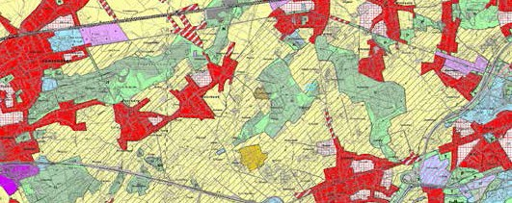
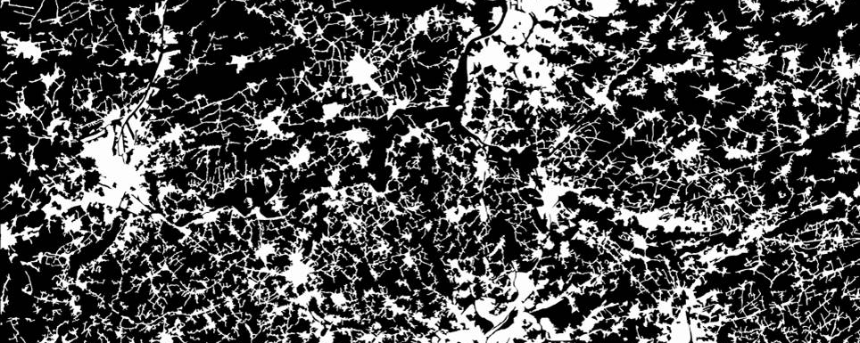
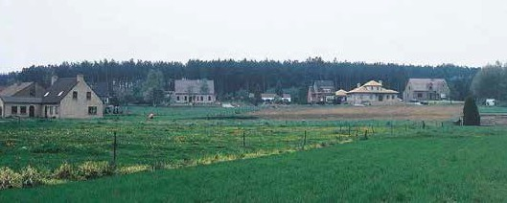
1
Gewestplan 1962 Leuven
After Sprawl (Xaveer De Geyter Architects)
Subdivisions in Flanders

Slide 3
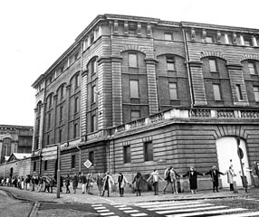
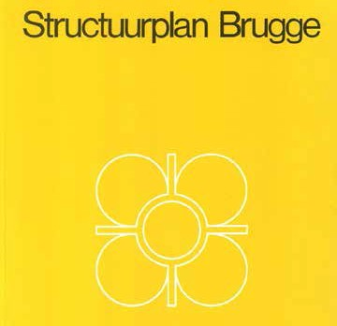
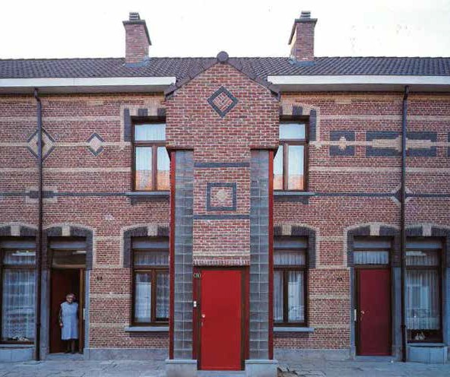
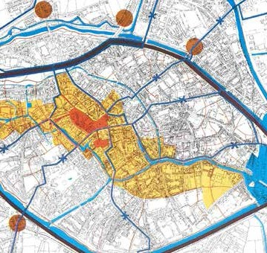
2
Protest movement against the demoli- tion of the Royal Entrepot (1968).
De demolition was executed in 1990.
Structure plan Brugge (1973)
“Herwaarderings- gebied Stuivenberg” (1984)
Renovation of social housing in Stuivenberg, Antwerpen.

Slide 4
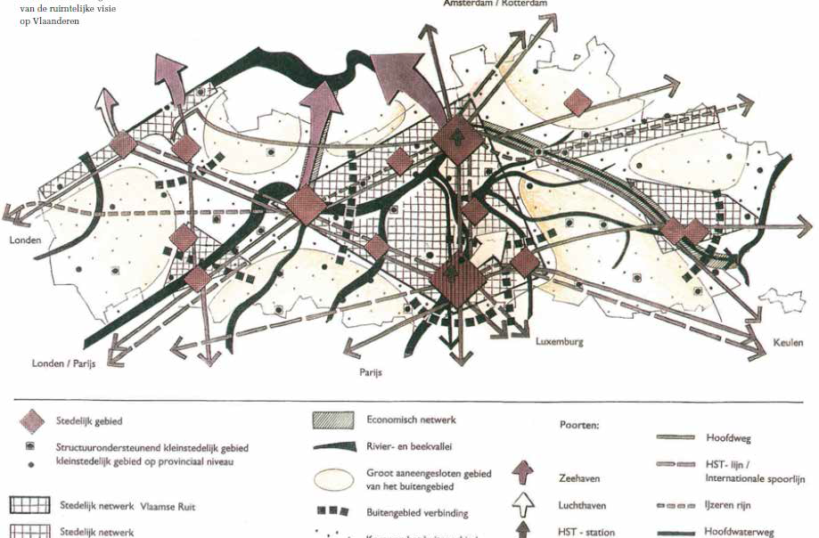
3
Structure plan Flanders (1997)

Slide 5
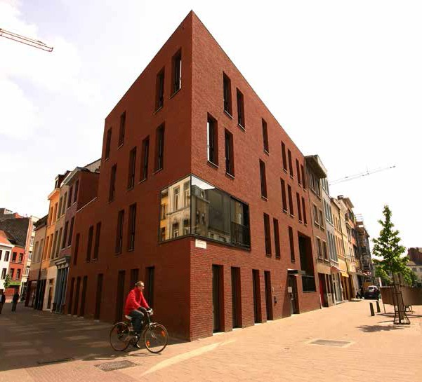
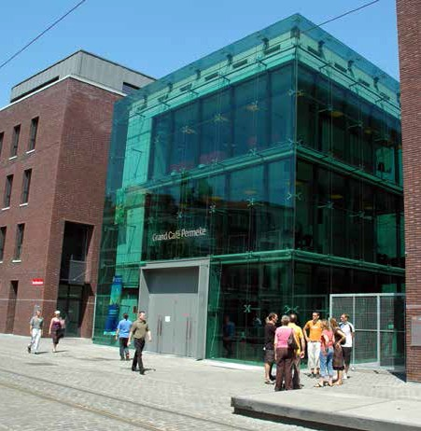
4
Urban renewal Central Station area, Antwerp
Urban renewal Schipperskwartier 1994 -2000, Antwerp

Slide 6
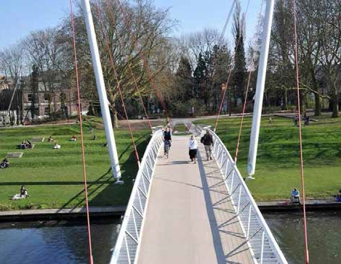
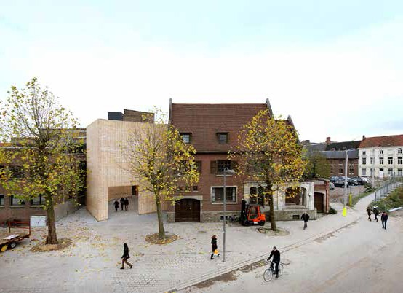
4
Buda eiland, Kortrijk
Ledeberg Leeft, Gent

Slide 7
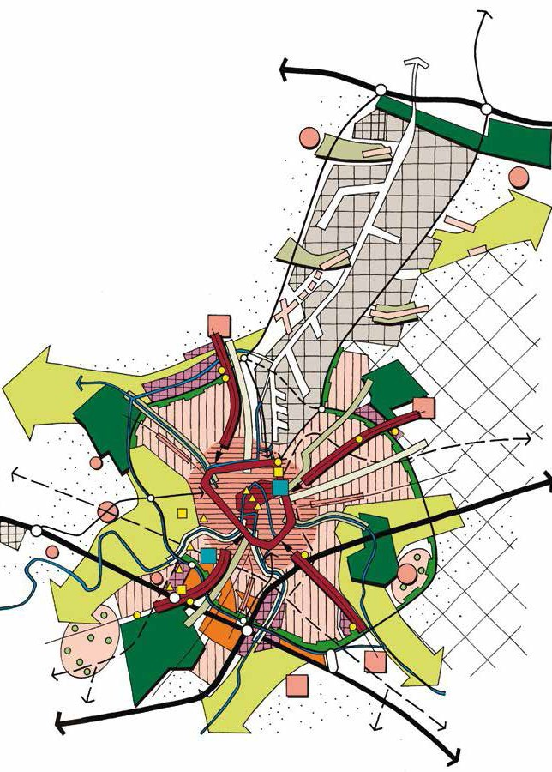
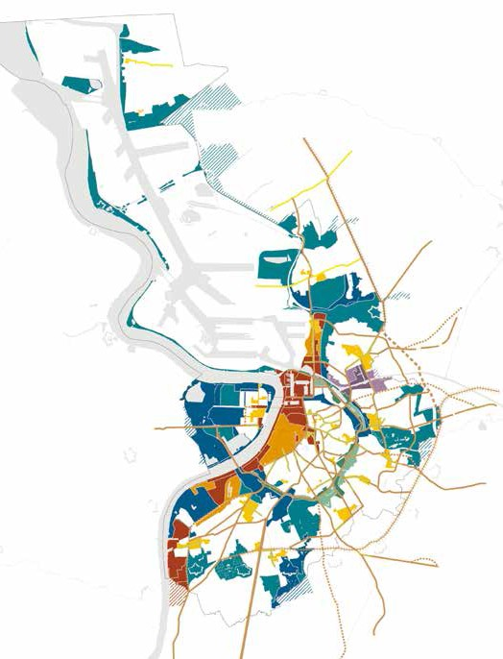
5
Structure plan Gent (2003)
Structure plan Antwerpen (2006)

Slide 8
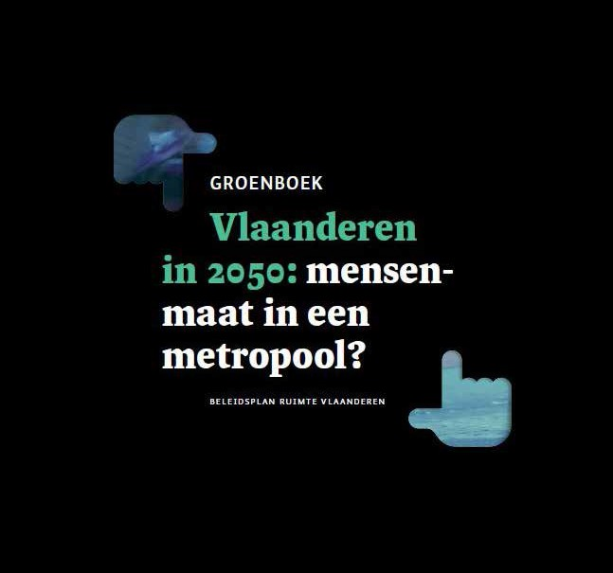
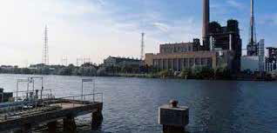
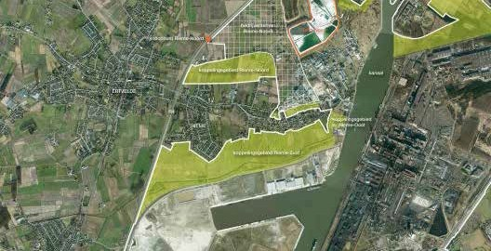
6
Project Gentse Kanaalzone
Groenboek, Beleidsplan Ruimte Vlaanderen, 2012

