Slide 1
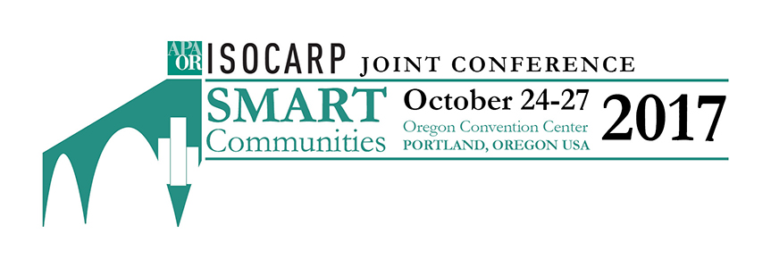

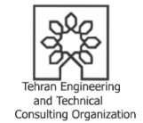
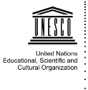
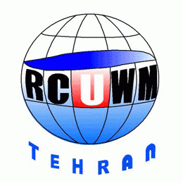
2017 ISOCARP AWARD FOR EXCELLENCE
Tehran Engineering and Technical Consulting Organization (TETCO), Tehran Municipality
&
Regional Center on Urban Water Management (RCUWM-Tehran) under the auspices of UNESCO

Slide 2
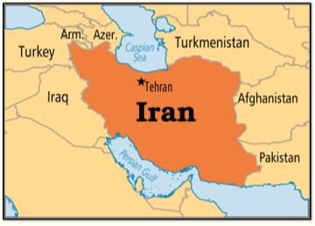
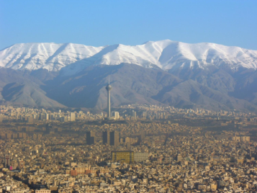
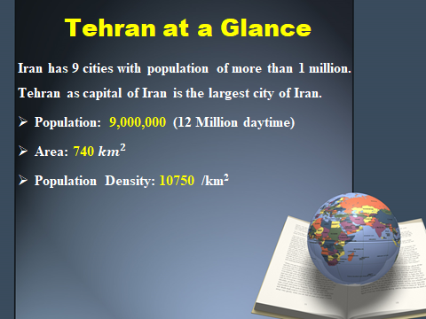
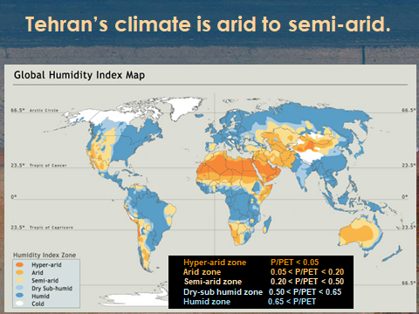
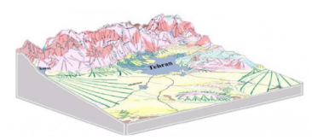



PROJECT LOCATION: TEHRAN, IRAN
Notes:
Tehran is the largest city in Iran with a population of about 9 million and around 12 million in daytime, making it the 18_{th} most populous city in the world. Tehran is considered as one of the largest cities in West Asia with a density close to 11,000 inhabitants per square kilometer.
Tehran is located in a semi-arid area with mean annual precipitation of 250 mm and average annual temperature of 16.5 C° (say it in Fahrenheit too).
It is a mountainside city with an altitude of 900 to 1800 meters above the mean sea level. The old city was formed at the altitude of 1200m. The city is located on the southern slopes of Alborz Mountain. Its main ridges overlook the southern slopes and Tehran plain, and form small drainage basins.

Slide 3
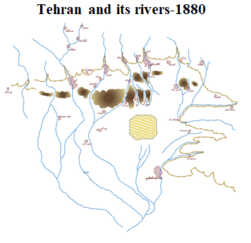
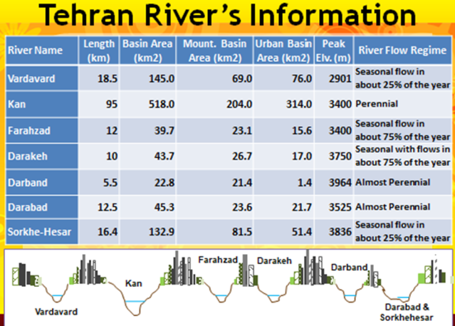
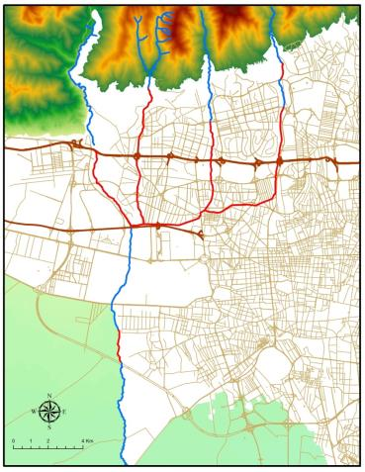
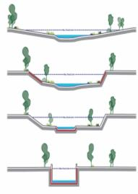
TEHRAN RIVERS: LOST LIFE!
Natural River
Channelized
Tehran 2015
Notes:
The total length of entire Tehran r5ver network within the municipality territory was about 170 km. People living in Tehran, practice various activities including: hiking, skiing, camping, picnicking and… enjoy high mountain as well as the nature of rivers in their free time.
However, Tehran rivers have been disappeared due to the rapid and disordered urban development over the course of the past half a century. Unfortunately, riverbed of Tehran became tighter or even vanished and main function of rivers was going to be forgot and they have became channels for disposal of wastewater and hazardous municipal wastes. Tehran Rivers were inaccessible for citizens inside the city with no role in the daily life of inhabitants.
22% (37 km) of them have been completely covered or buried. Moreover, 60% (102 km) of this river network is channelized using concrete walls or the natural river courses have been cut for flood protection. But, Tehran is still facing river flooding, especially flash floods.
Neither concrete flood walls nor flood bypasses were able to make Tehran safer against floods: 386 people lost their lives due to flash floods on 26 July 1987 in the North of Tehran. Tehran is experiencing urban floods frequently and the last one was in 2015 with 6 death toll.

Slide 4
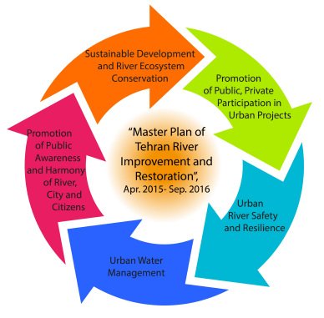
TEHRAN RIVER RESTORATION: LEGAL FRAMWORK AND MOTIVIATION
Tehran Master Plan developed in 2007 considered rivers and water bodies as the main axis of the city structure
River and water bodies are considered as an important element of Tehran city in the “Five-year Plan” of Tehran Municipality (2014-2018).
UN Sustainable Development Goals (SDGs ) No. 11: “Sustainable Cities and Communities; Make cities and human settlements inclusive, safe, resilient and sustainable”
Master Plan of Tehran River Improvement and Restoration
Notes:
To over come this problem, the latest Tehran Master Plan developed in 2007 considered rivers and water bodies as the main axis of the city structure. Moreover, River and water bodies are considered as an important element of Tehran city in the “Five-year Plan” of Tehran Municipality (2014-2018). With these plans and also considering UN SDG No. 11 on “Sustainable Cities”, Tehran river Restoration and Improvement Plan” has been studied from Apr. 2015 to Sept. 2016. The implementation phase has been started with five main objectives:
1- Urban River Safety and Resilience
2- River Ecosystem Restoration and Conservation
3- Harmony of River, City and Citizen
4- Sustainable Urban Water Management
5- Promotion of Public, Private, Participation (PPP)

Slide 5
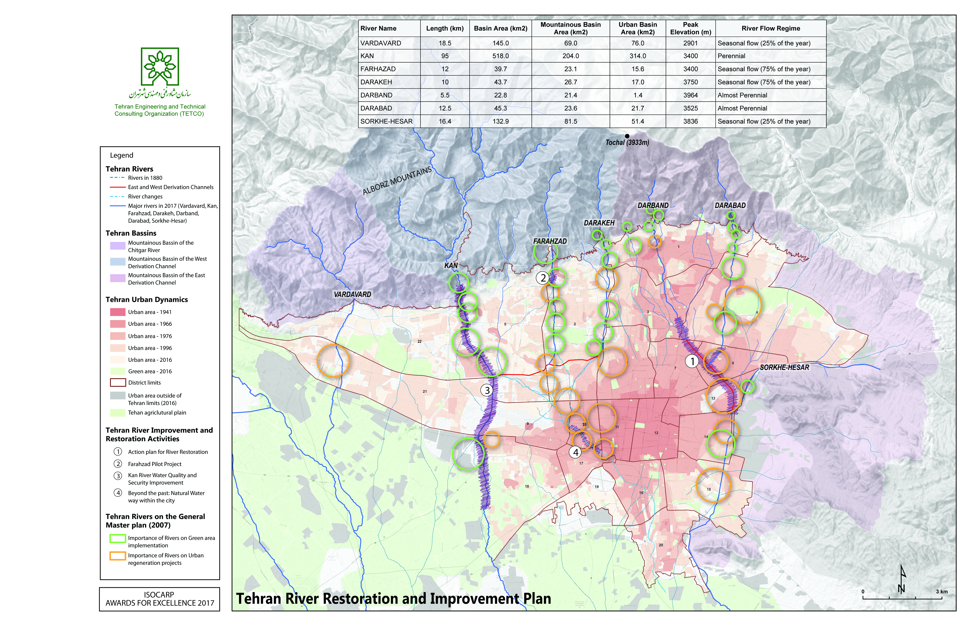
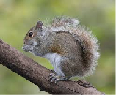
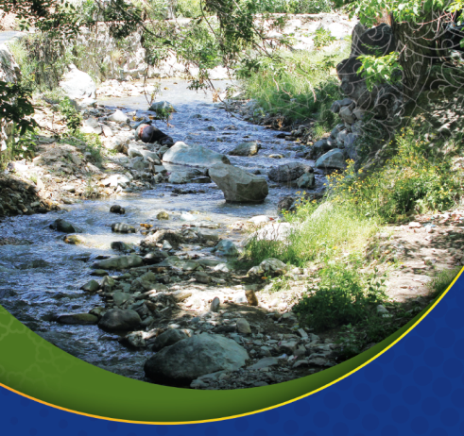
MAIN FEATURES OF THE PROJECT
Notes:
Particular aspects of Tehran river restoration study are as follow:
- Restore, enhance and preserve the urban river environment using restoration approach
- Enhance recreation opportunities and enjoyment of the urban river system by application of Nature-oriented River Restoration pentagon
- Develop and implement “Best Management Practices” for living with urban rivers utilizing “Smart Communities” approach and using “Smart communities” tolls to recognize and celebrate the natural values of urban river systems.
Worth noting that as river restoration projects are multidisciplinary, so it should be taken in to consideration the communication with different stakeholders.

Slide 6
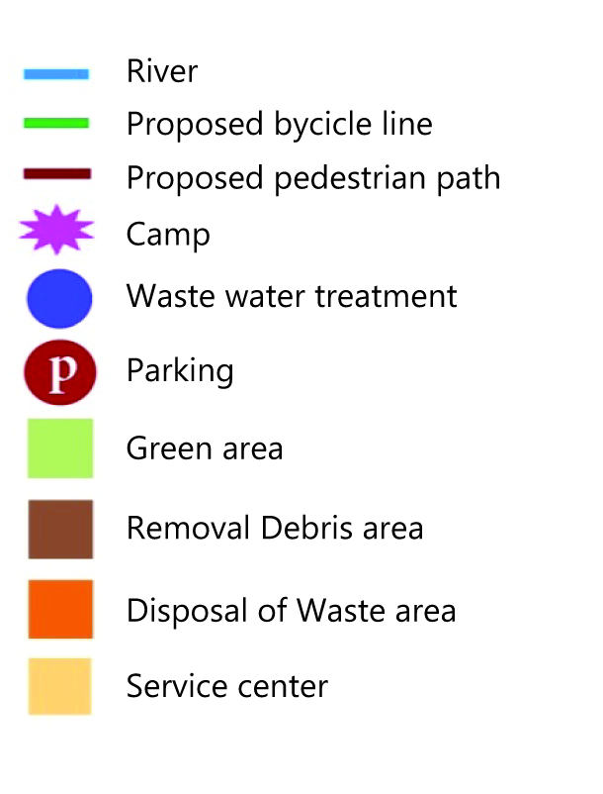
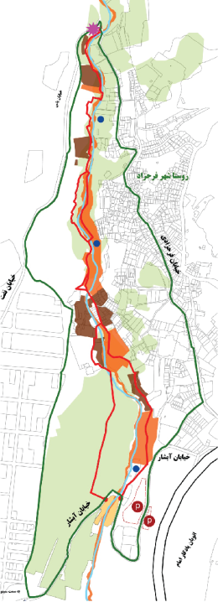
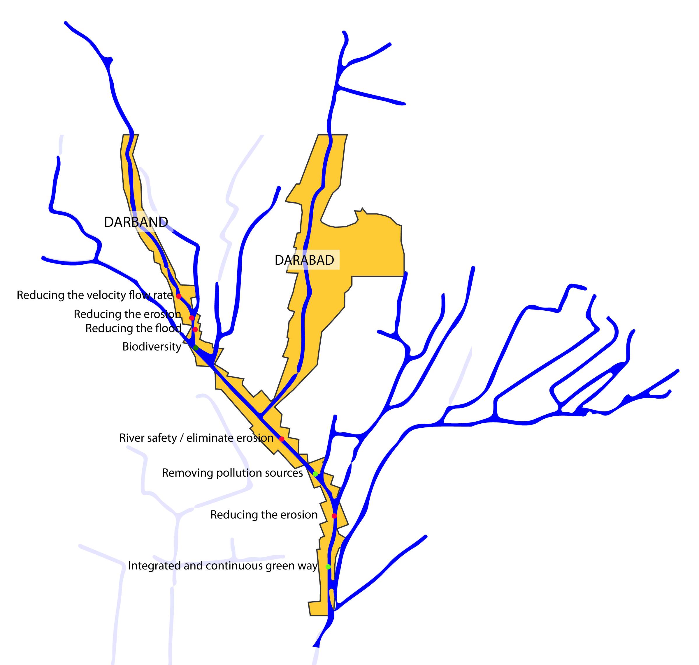
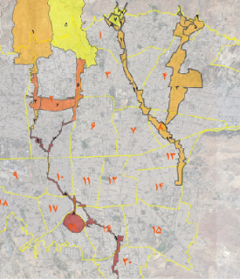
ACTION PLAN
Classification of damages to Tehran Rivers at each segments using Multi-Criteria Decision Making (MCDM)
Severe Damage (e.g. buried river)
Highly damaged (e.g. covered river)
Moderated damage (concrete walls)
Low impact (e.g. unauthorized residence)
Natural condition and need to be conserved as it is
Notes:
Several activities have been carried out during the first two years of Tehran River Restoration and Improvement Plan including precise and multidisciplinary studies, holding conferences and workshops for the experts and citizen on urban river restoration, implementation of ecological pilot project, public awareness and participation… in order to achieve a reliable action plan with detail criteria and river segmentation for dedicated intervention as follow:
- Identification of real estate located in the river basin, ownership and payback, demolition plan, dumping and discharge of construction waste
- Implementing waste disposal plan
- Consecution of local sewage treatment plant
- Early flood warning system and stabilizing river bank slopes using green and flexible protections
- Local vegetation restoration
- Accessibility to the river floow and creating multi-purpose river space

Slide 7
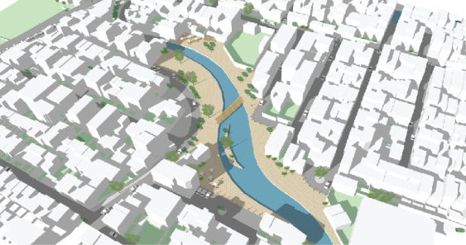
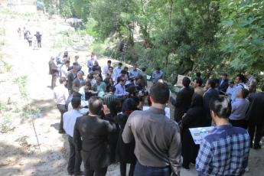
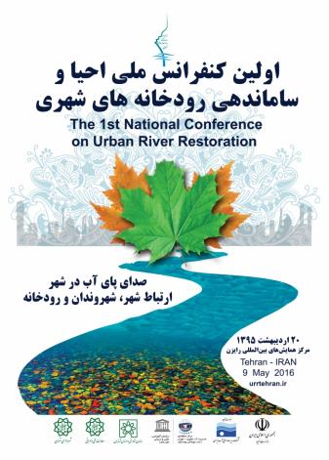
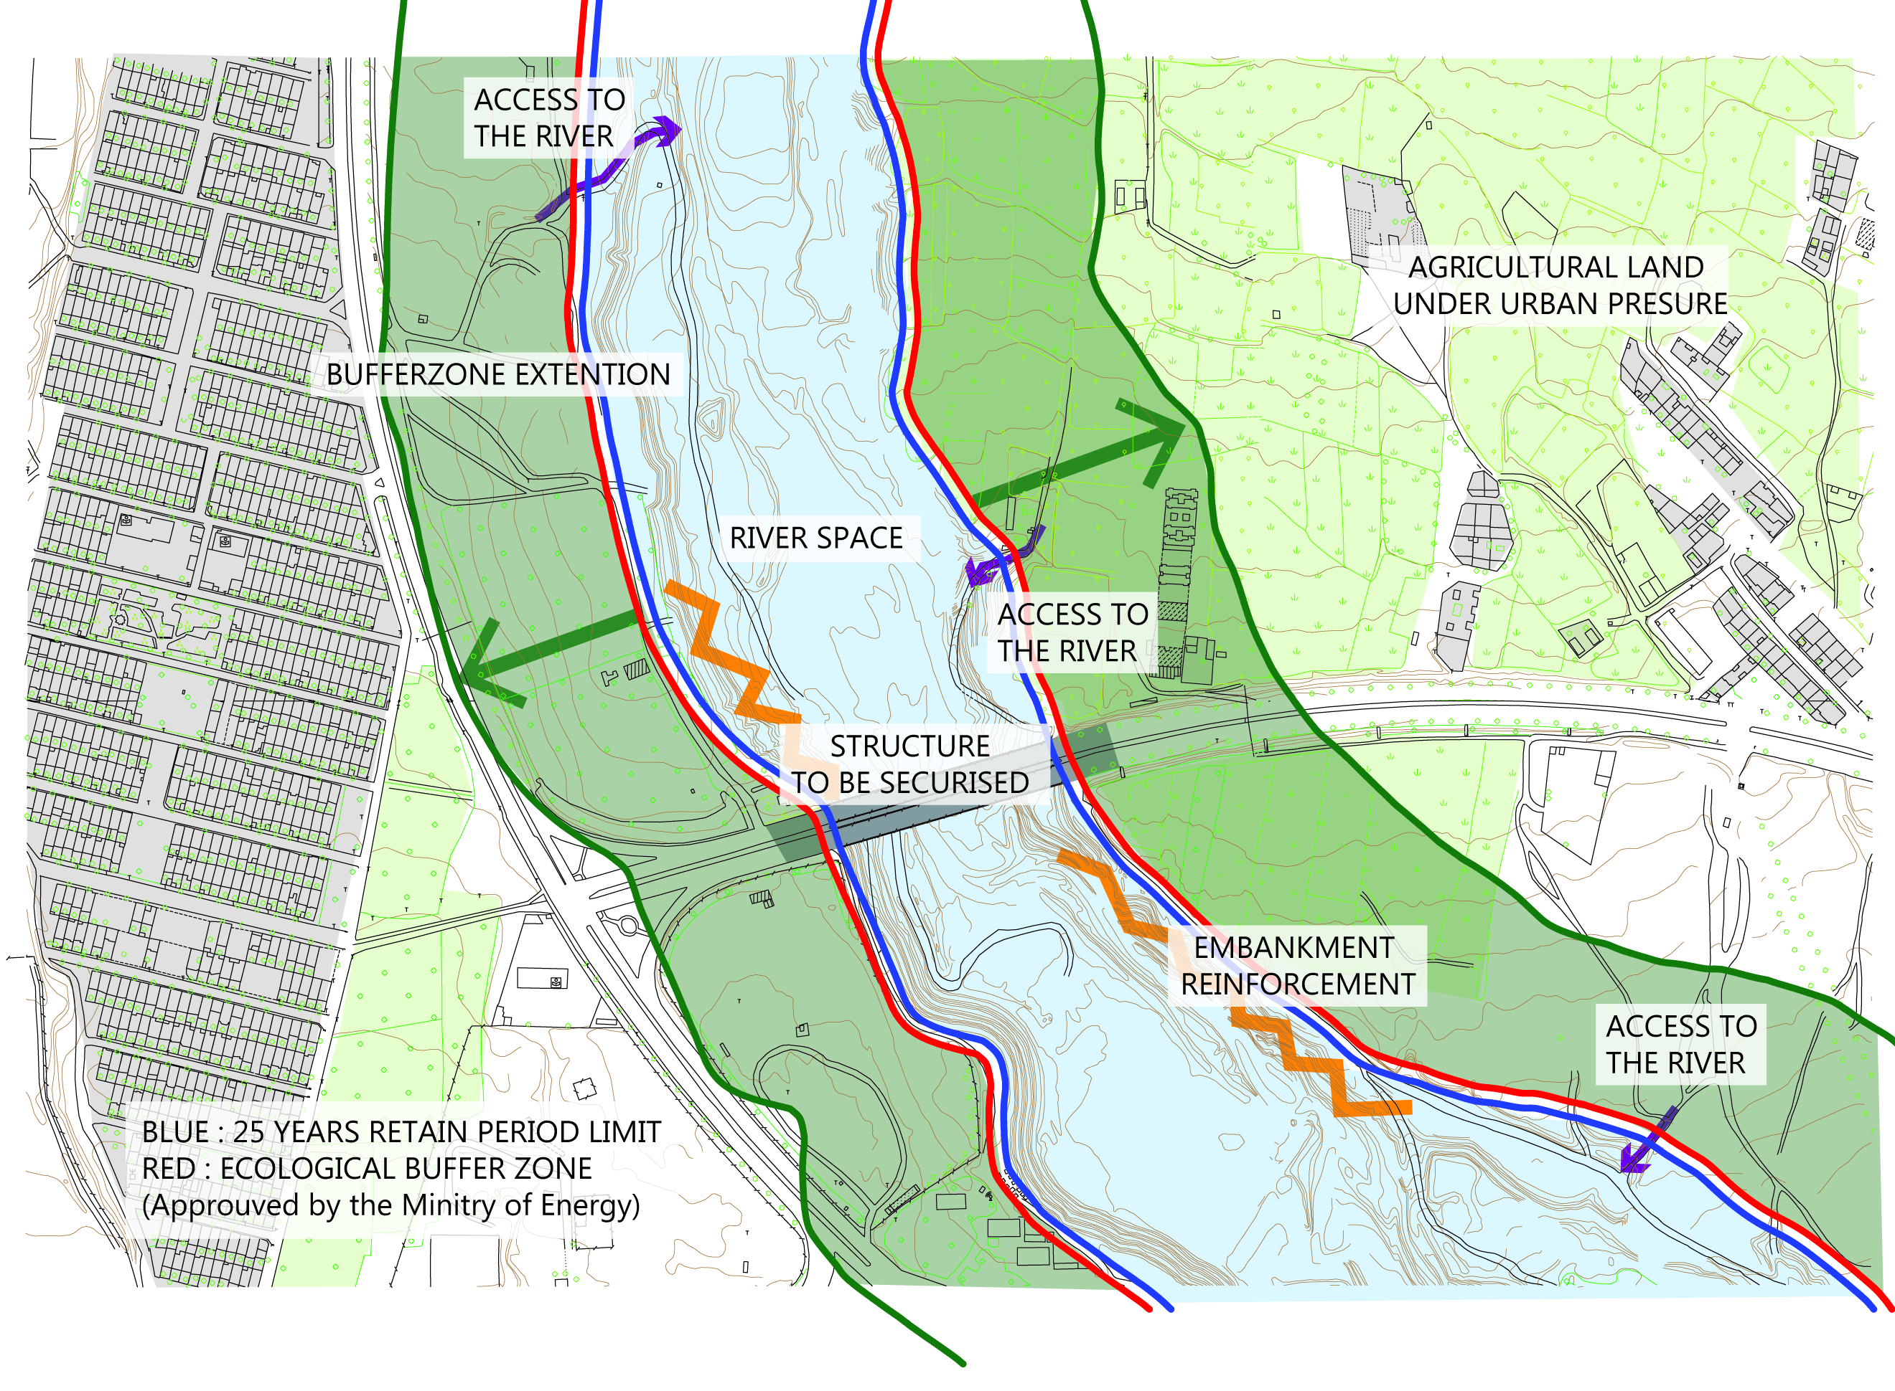

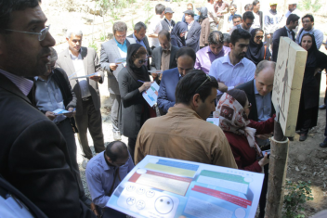
SMART COMMUNITY TO MANAGE NATURAL WATER WAY
Notes:
The past changes in Tehran rivers, has altered the water network of the city. International experiences in Tokyo-Japan, Seoul-Korea, Los Angeles-U.S. and other projects in Europe illustrate ambitious river renovation programs will not archive its objectives without pubic participation and using smart community approach.
Special zone developed on the natural oriented water way in order to improve public awareness at community scale and finally connect citizens to their rivers. The important issue is that the river fringe should be based on the 25-years flood return period, equipped with effective structures such as bridge piles or embankment reinforcement. The actual urban dynamics invite utilize ICT for the flood forecasting and early warning system as an important elements of the restoration plan.
Successful urban river restoration in Tehran is as much about establishing trust with local people as it is about improving flows and habitats.

Slide 8
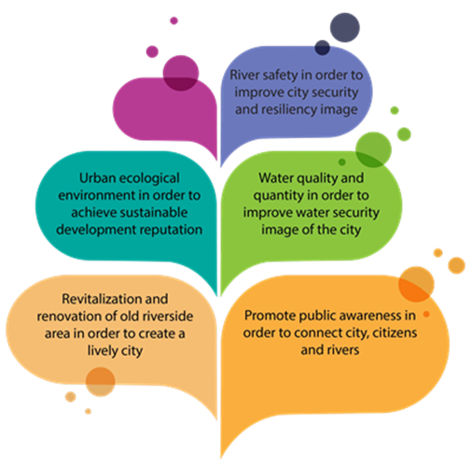
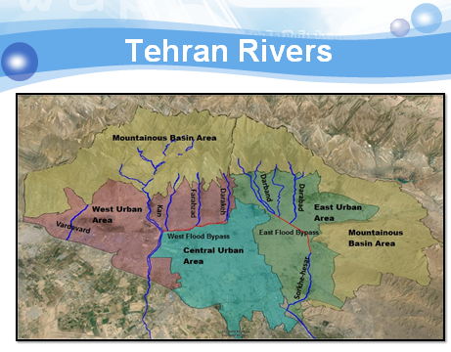
CONCLUSIONS
Notes:
Study of “Tehran River Improvement and Restoration plan” has been launched in 2015. The overall study objective is to create and promote connectivity between, and attractiveness of, Tehran Rivers, City and Citizens on various scales ranging from local urban design to the city’s overall spatial development. The project contributes to a new image of Tehran City by achieving following main goals:
1- Urban River Safety and Resilience
2- River Ecosystem Restoration and Conservation
3- Harmony of River, City and Citizen
4- Sustainable Urban Water Management
5- Promotion of Public Awareness and Public, Private, Participation

Slide 9
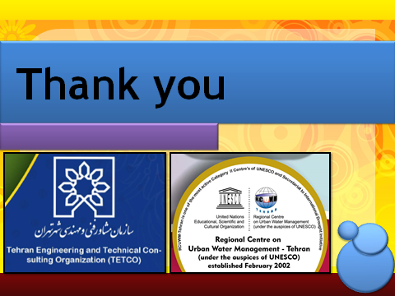
Contact:
Tahmaz Ahmadpour, TETCO-Tehran Municipality, info@tetco.org
Ali Chavoshian, RCUWM under the auspices of UNESCO, info@rcuwm.org.ir
chavoshian@gmail.com

