Slide 1

国际青年规划师工作坊 International Young Planners Workshop
GROUP 2
Guangzhou, 2016

Slide 2
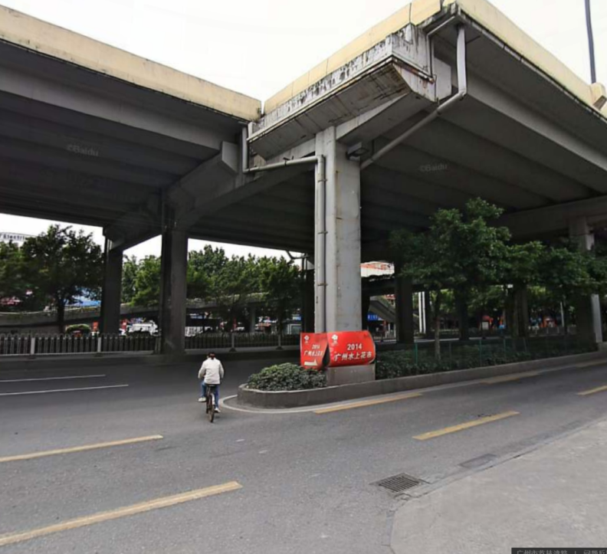
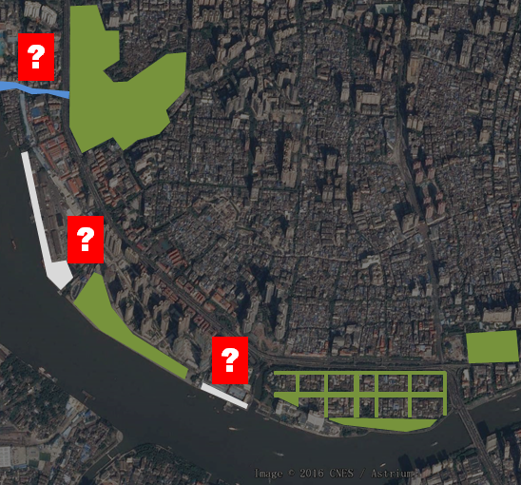
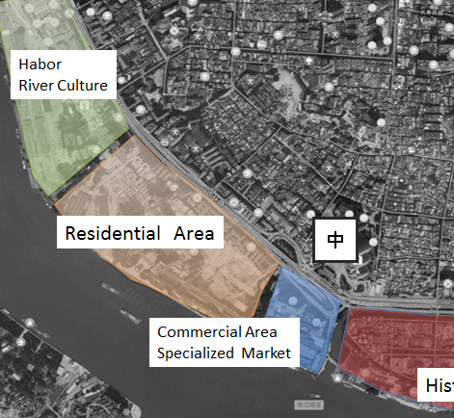


Key Problems 核心问题
ISOLATION DISCONNECTION DIVERSITY
隔离 断裂 分异
YPP 2016 Guangzhou

Slide 3
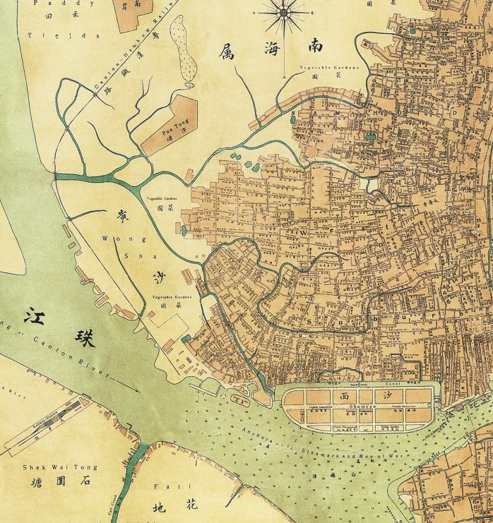
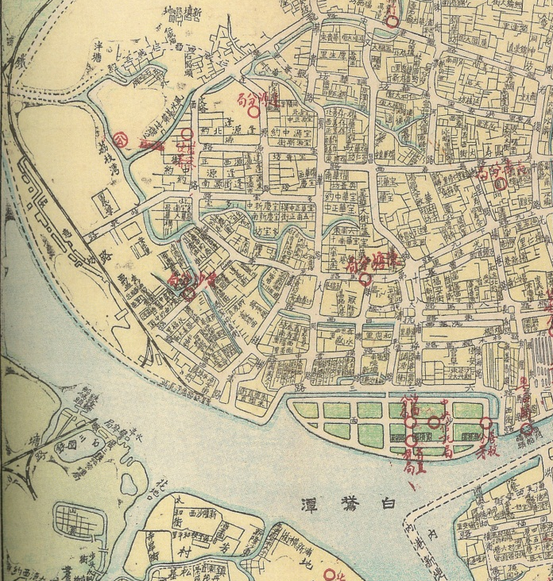
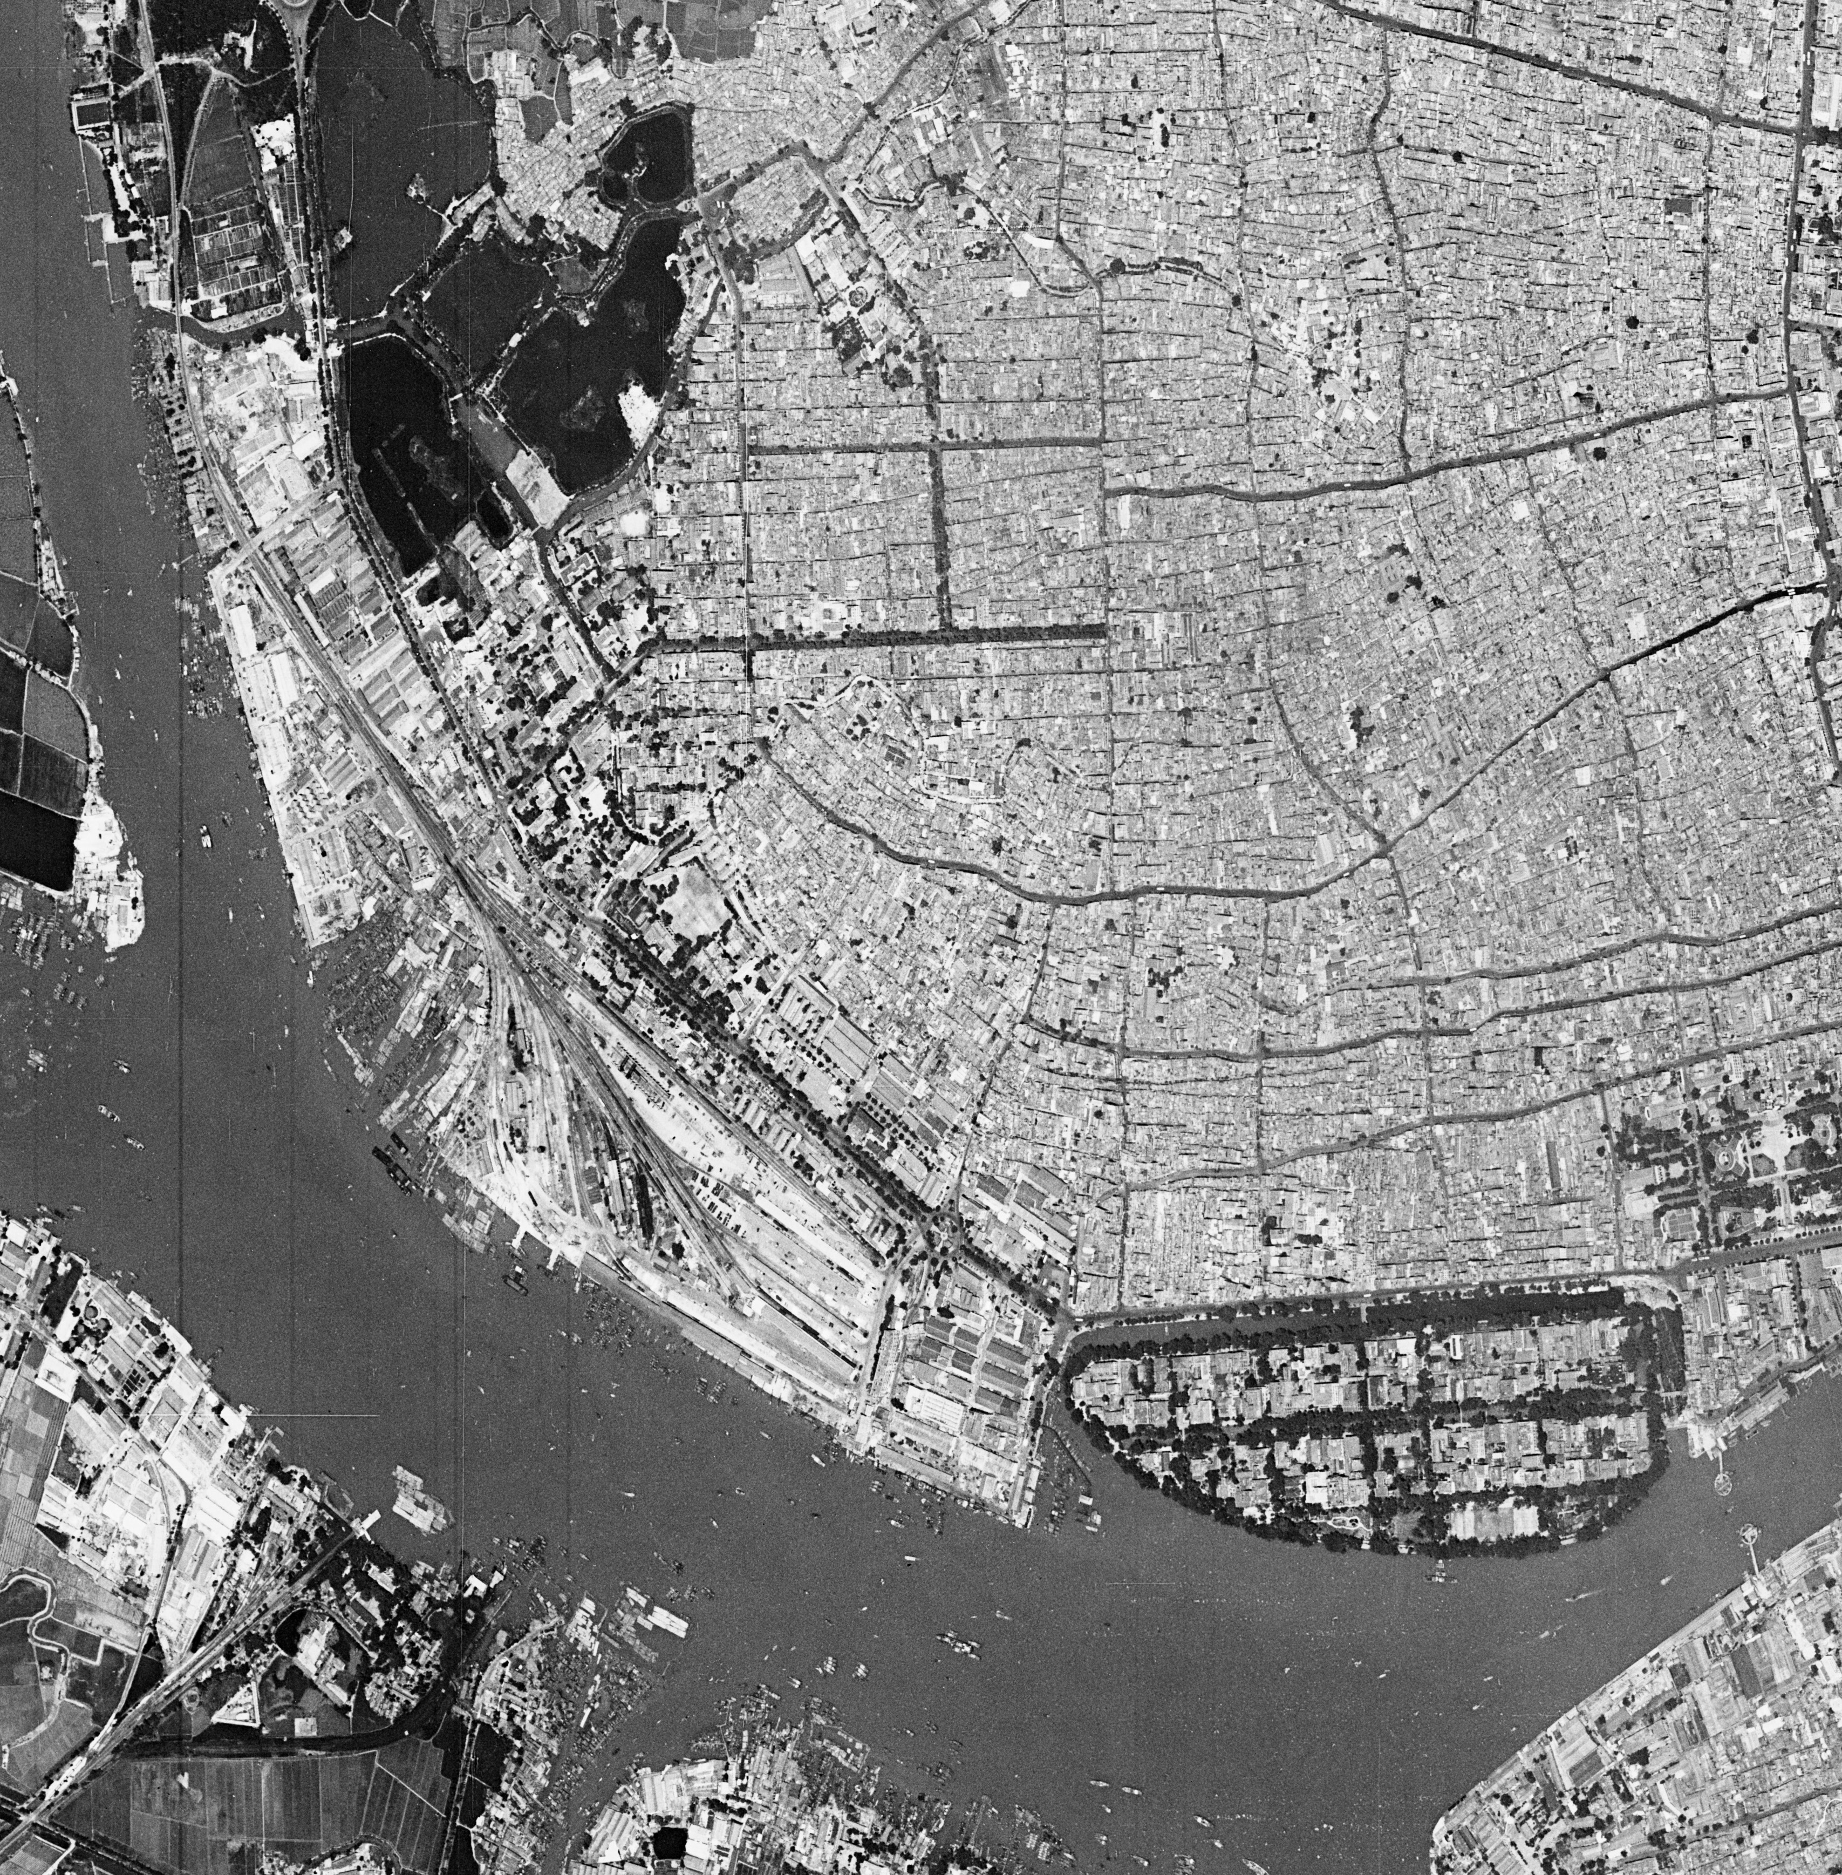
Reasoning 缘由
Always been the FRINGE
长期作为城市“边界”
1907 1938 1966
YPP 2016 Guangzhou

Slide 4
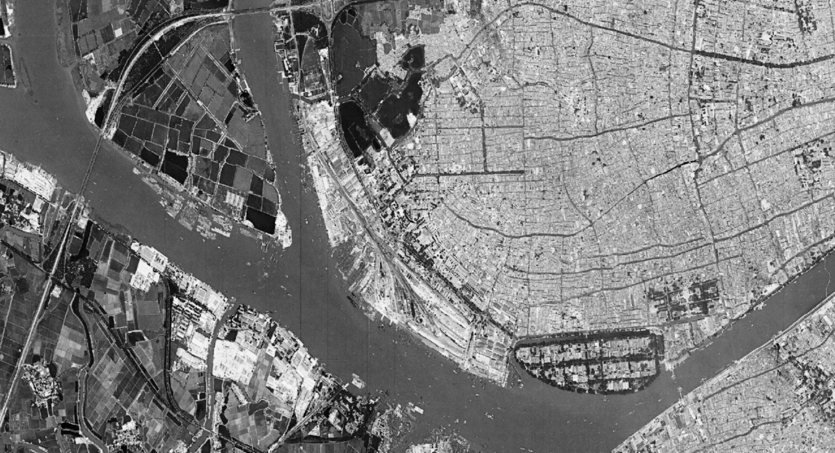
Never made for the PEOPLE
从未“以人为本”
Shamian Island: from Song Dynasty(mid 10th)
The Former South Railway Station:from Qing Dynasty (1901)
The Xinfeng Harbor:Station:from the founding of new China(1949)
The Huangsha Seafood Market:from 1994
The Guangzhou Zhuguang No.1resideial area:from2016
From 1949
From Qing Dynasty(1901)
From 2016
From 1994
From Song Dynasty (Mid 10th)
1966

Slide 5
ime o urn
YPP 2016 Guangzhou

Slide 6
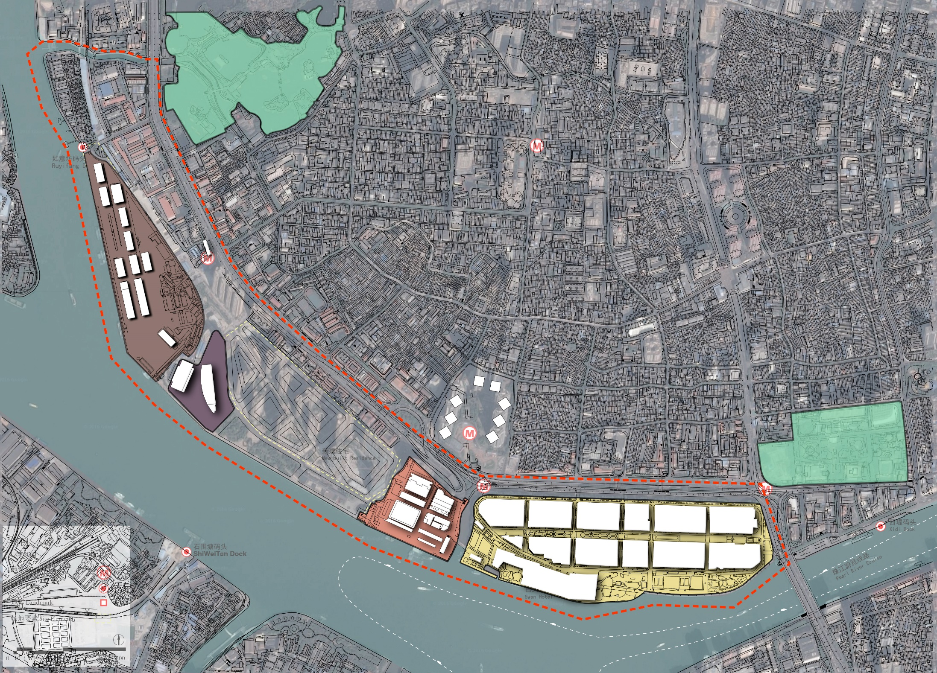
What ATTRACTS people to look the other way?
Public Park 公园
Xinfeng Habour 新风港
Old Railway Station 老南站
Huangsha Fish Market 黄山市场
Shamian Island 沙面岛

Slide 7
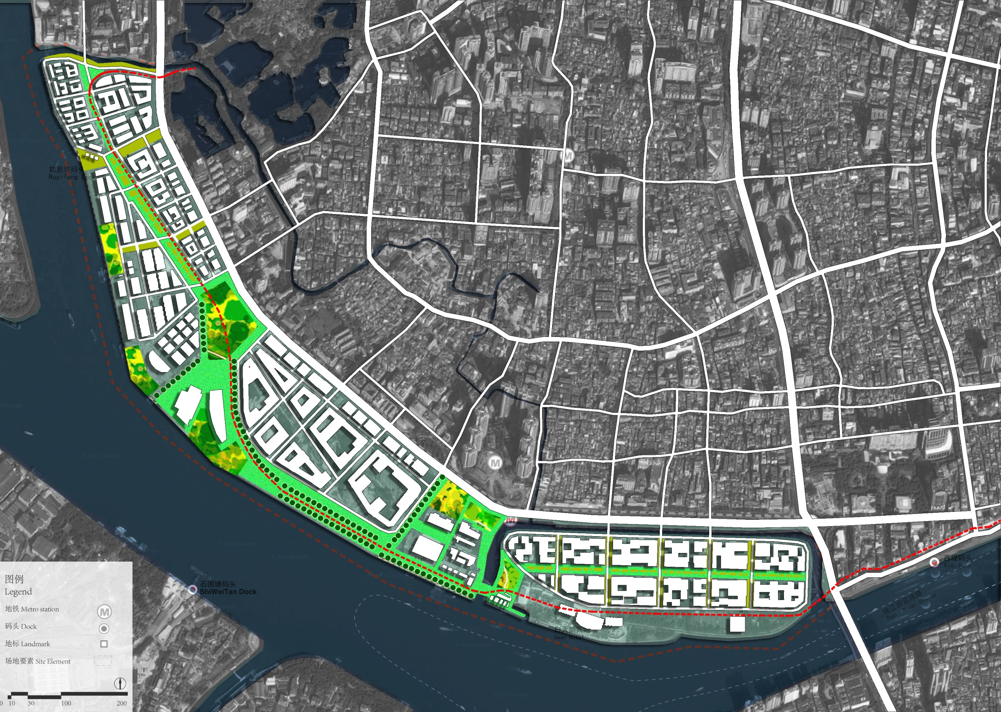
1KM

Slide 8
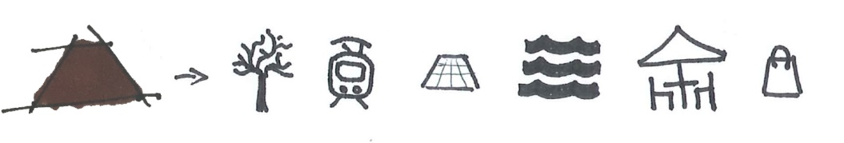
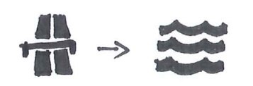
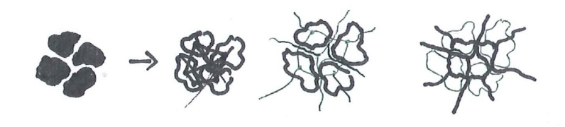
Tourism
(Culture, Green Space)
Traffic
(Circulation, Centrality)
Trend
(Identity, Environment)

Slide 9
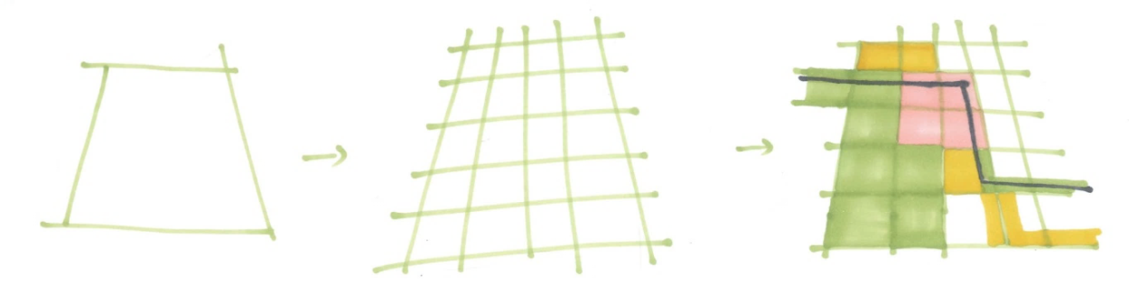
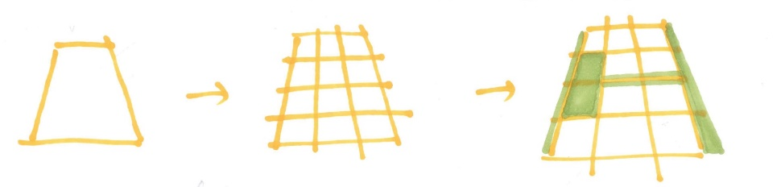
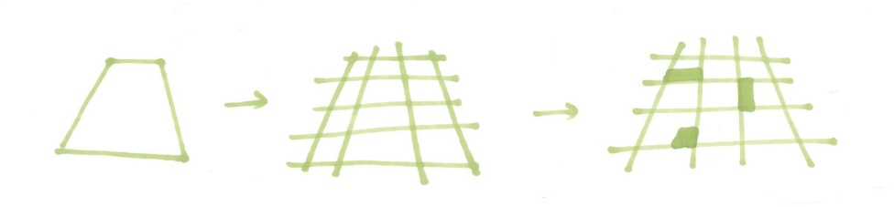
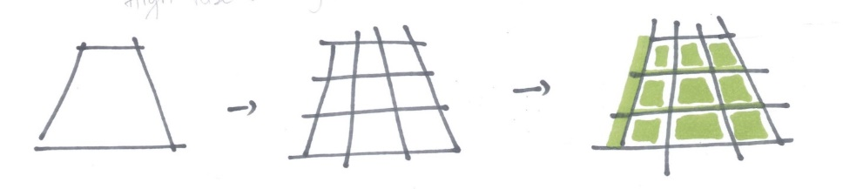
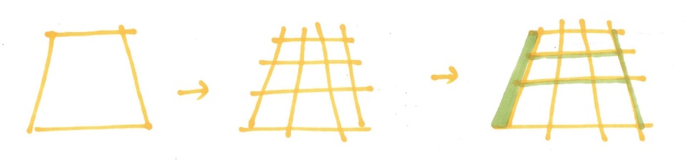
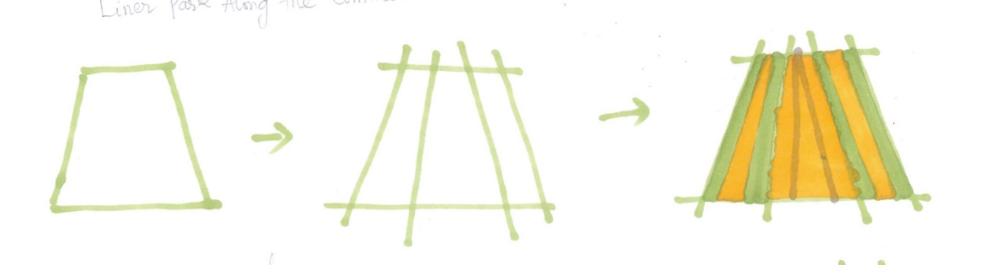
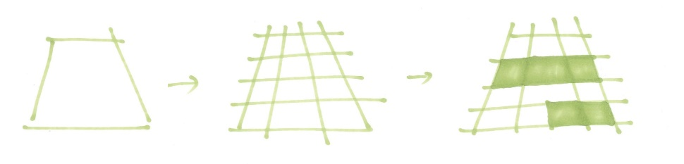
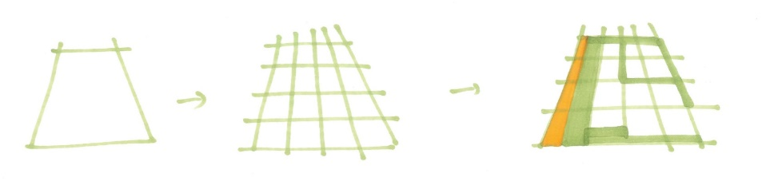
Tourism A Series of Historical and Green Spaces
The diagram for residential area
The diagram for waterfront commercial
The diagram for landmark open space
The diagram for highway commercial
The diagram for high-rise residential
The diagram for linear park
The diagram for Fish Market
The diagram for Shamian Island

Slide 10
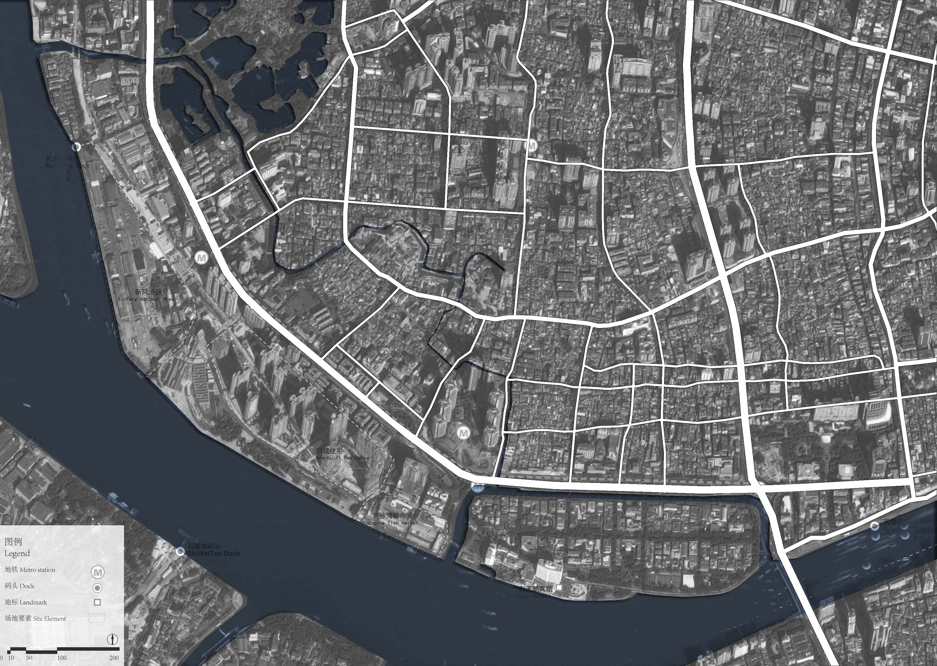
Traffic A Circulation system to guide people in
Metro 地铁
Main road 主干路
F
Secondary road 次级路
F
Tram 电车
Ferry 轮渡
M
M
M
F
F

Slide 11
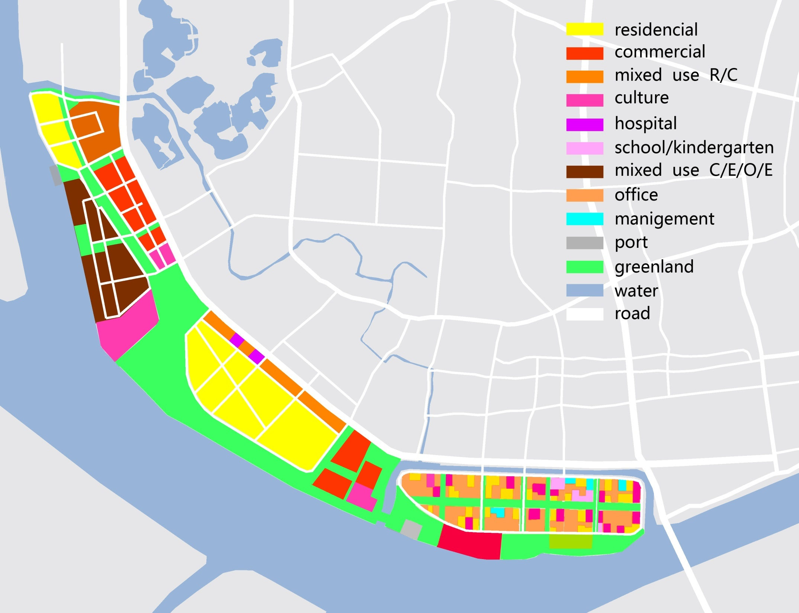
Trend A Preserved Identity for Social Groups
LANDUSE

Slide 12
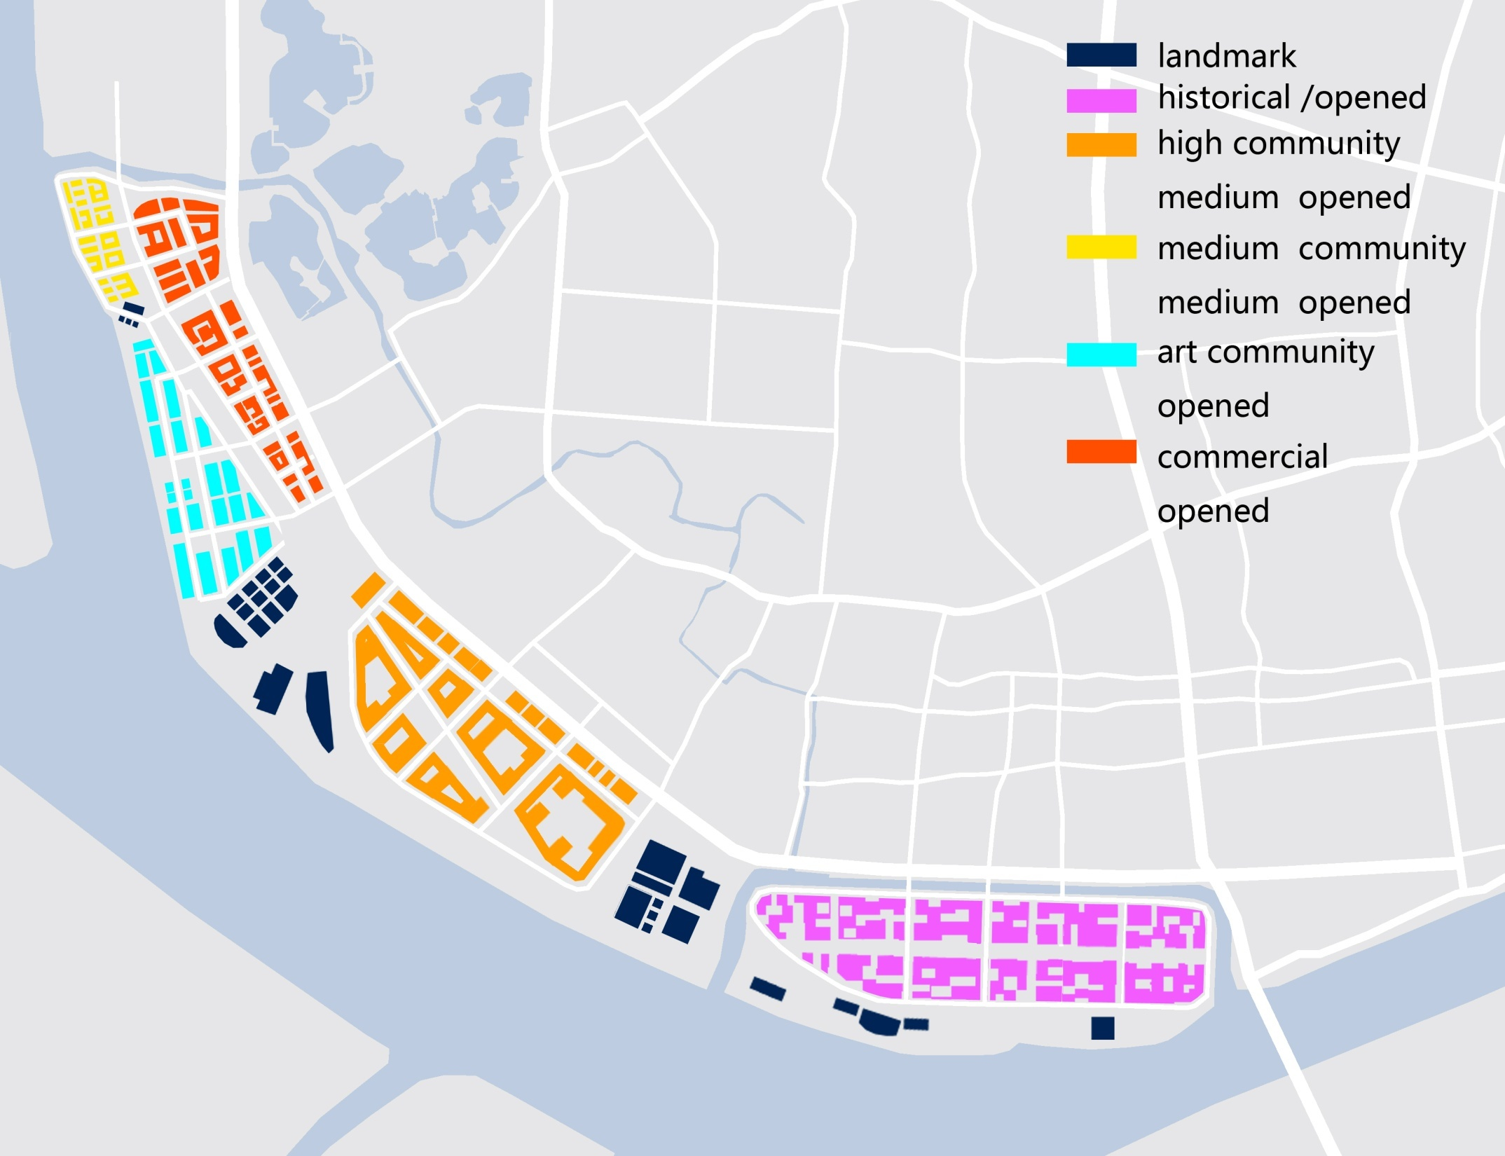
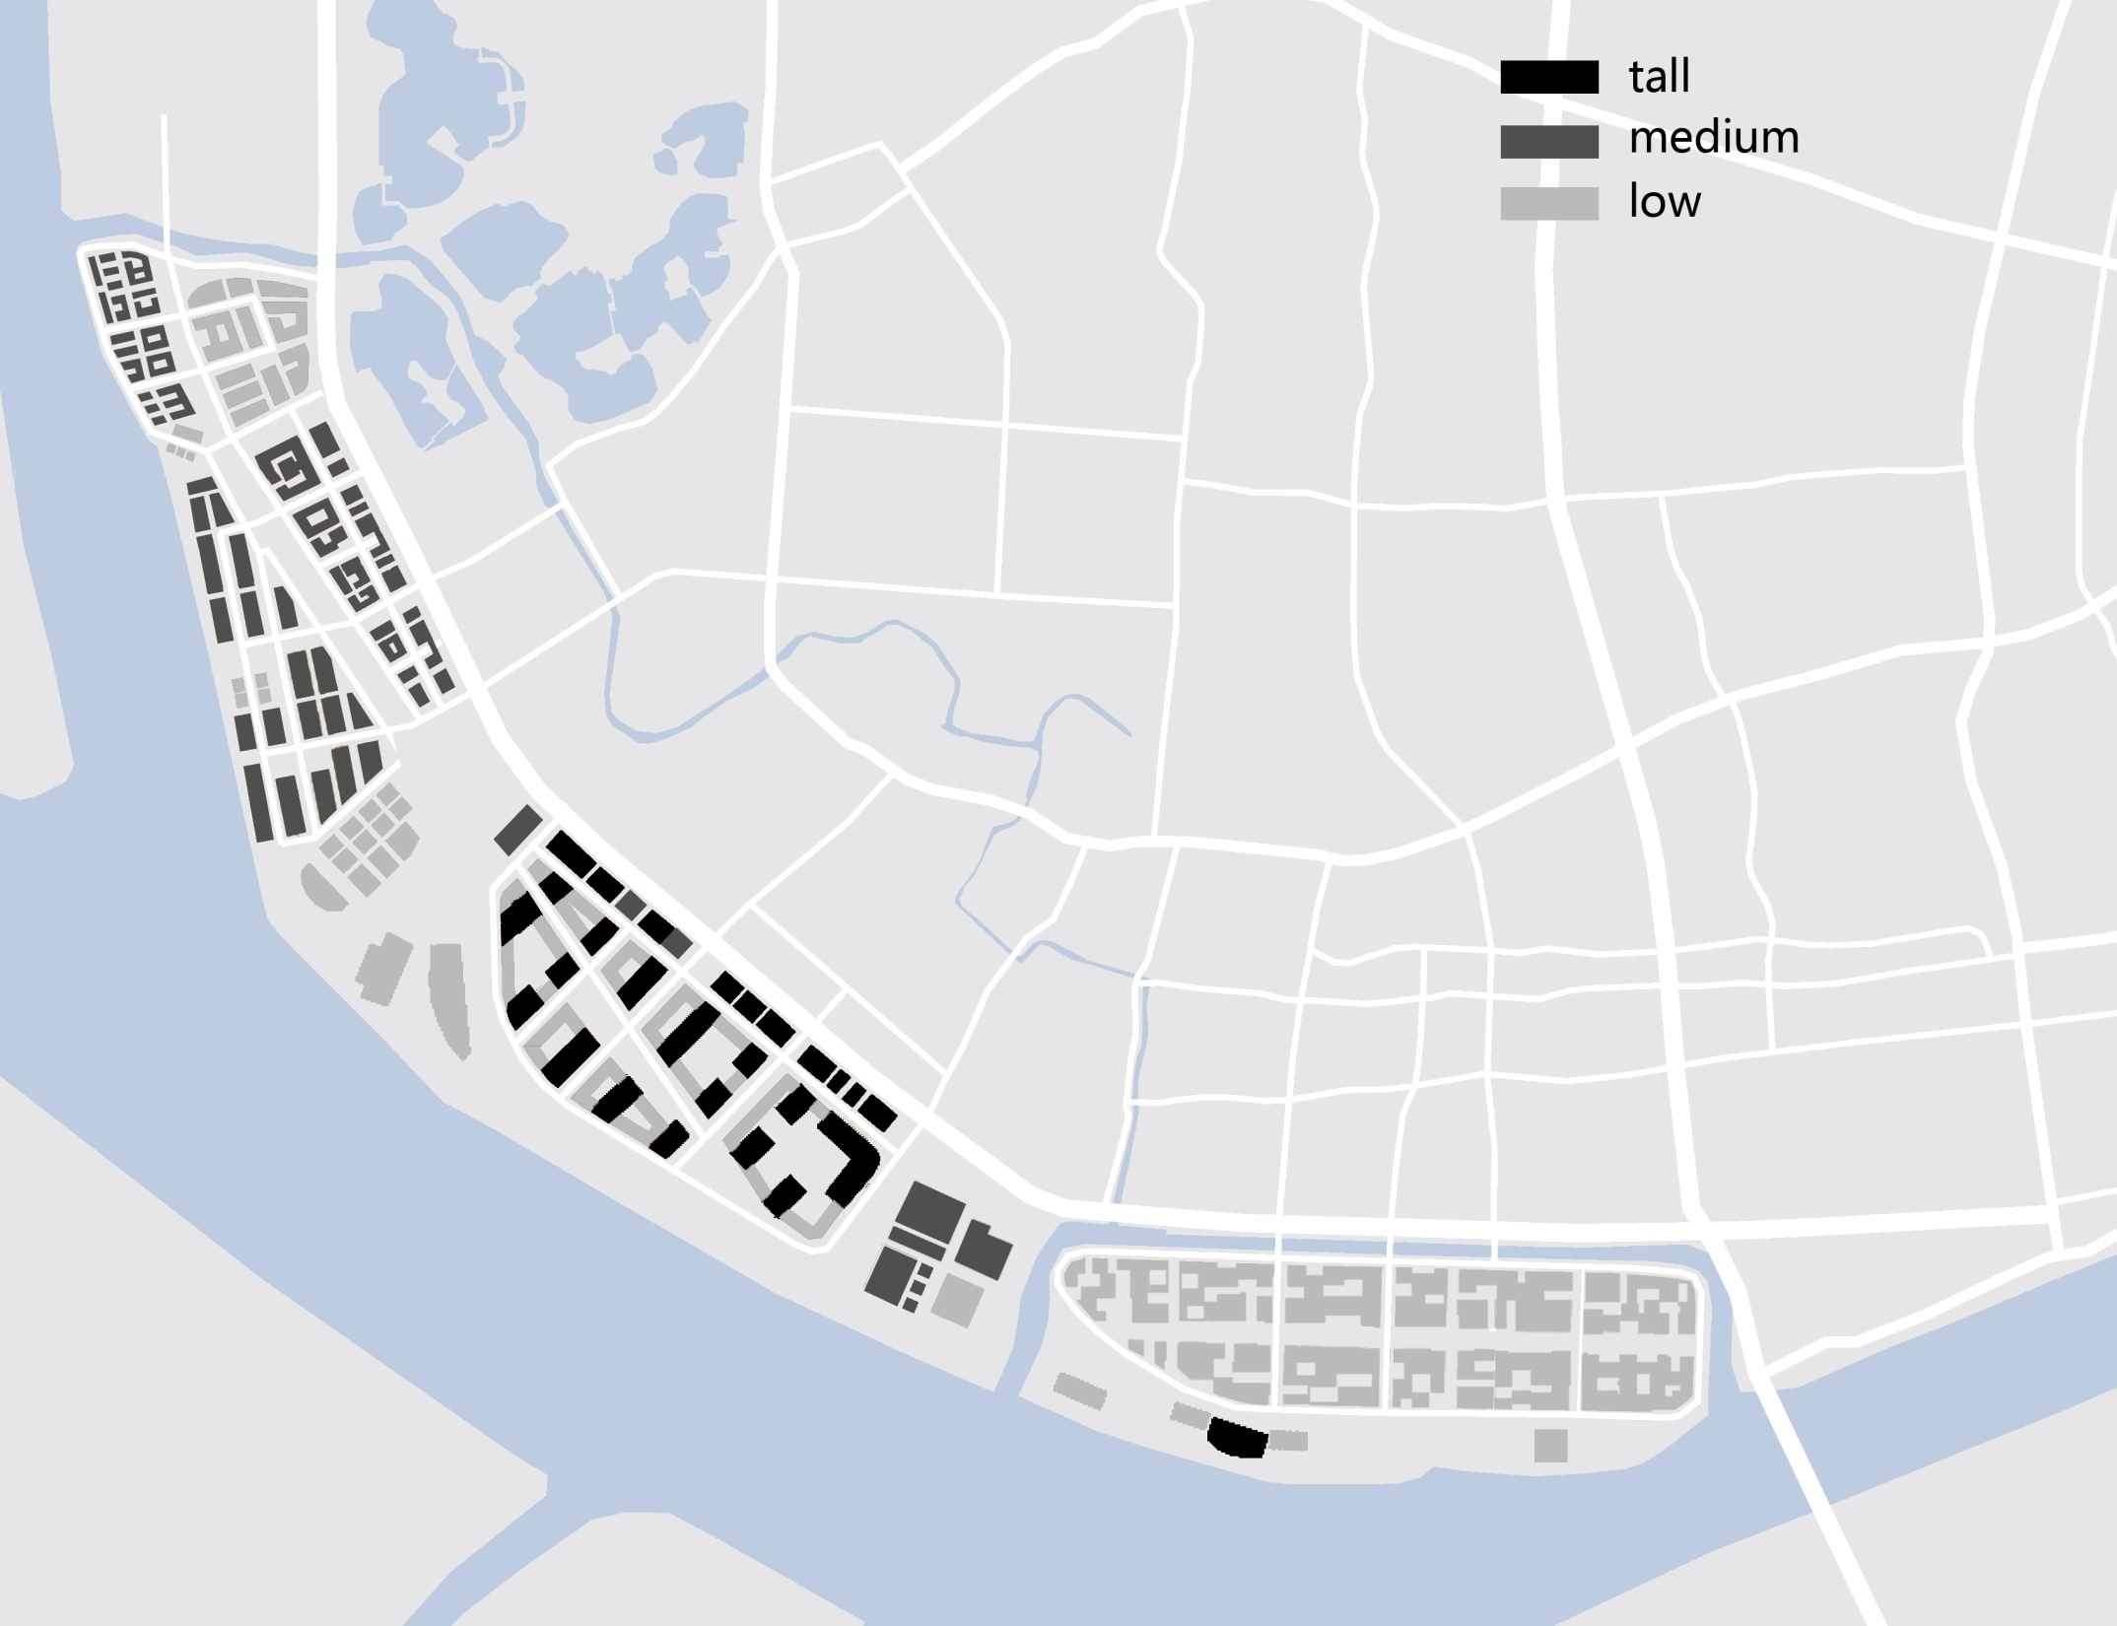
Trend A Preserved Identity for Social Groups
BLOCKS
FOOTPRINTS
ime o urn

Slide 13
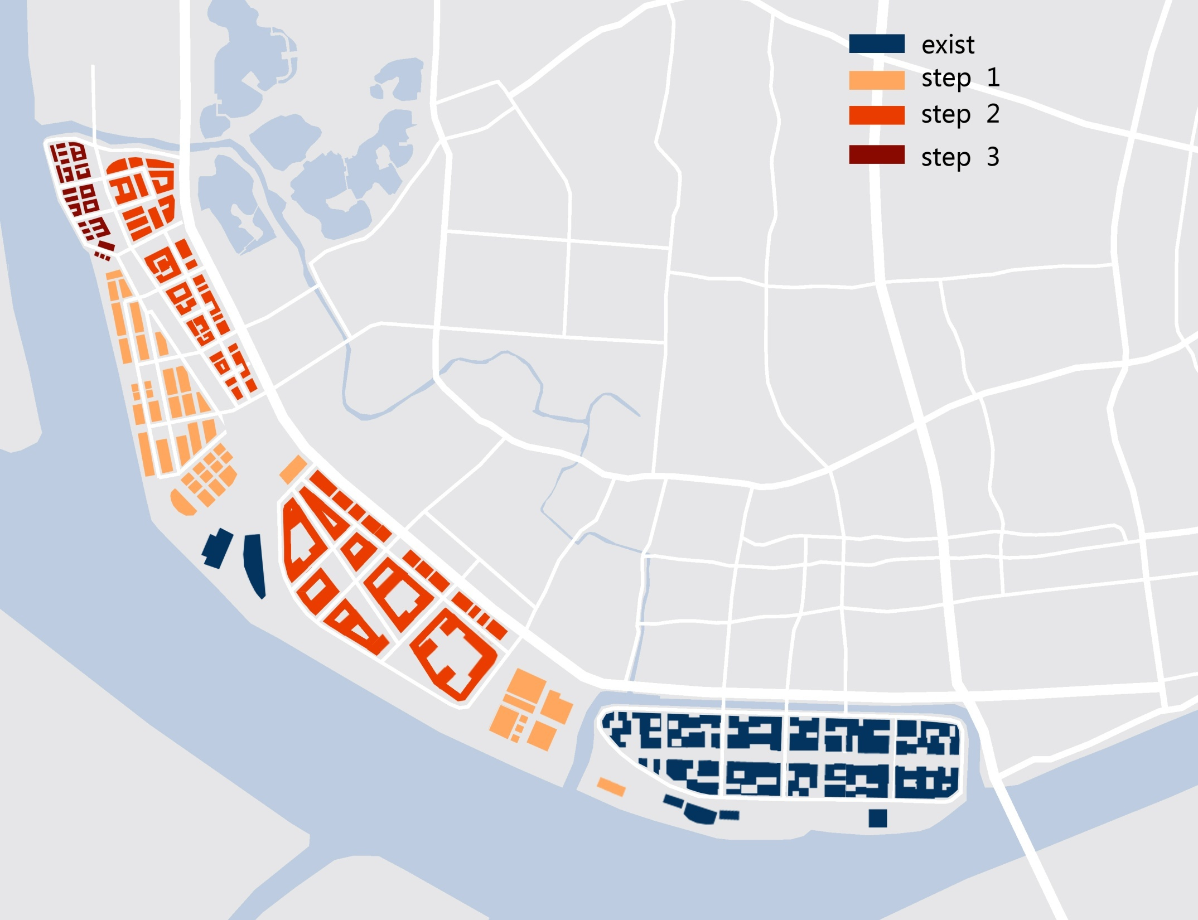
Timeline

Slide 14
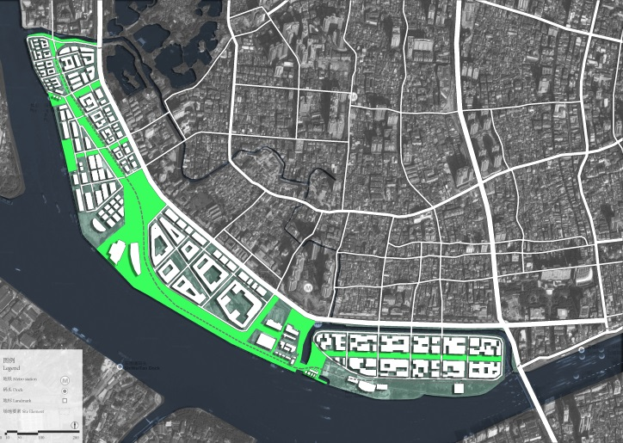
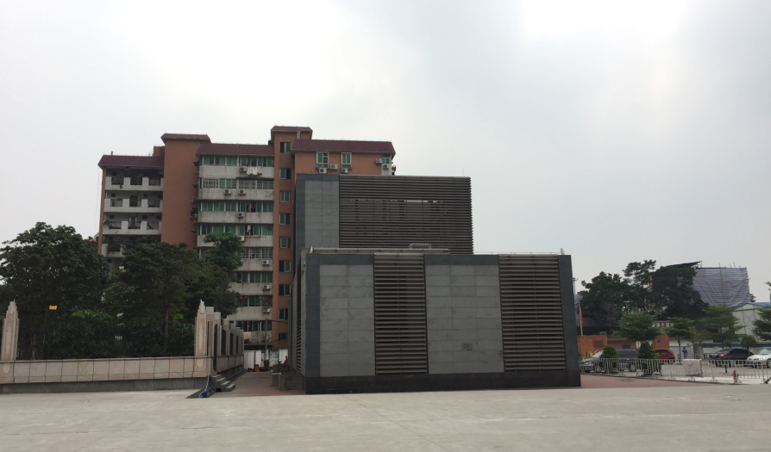
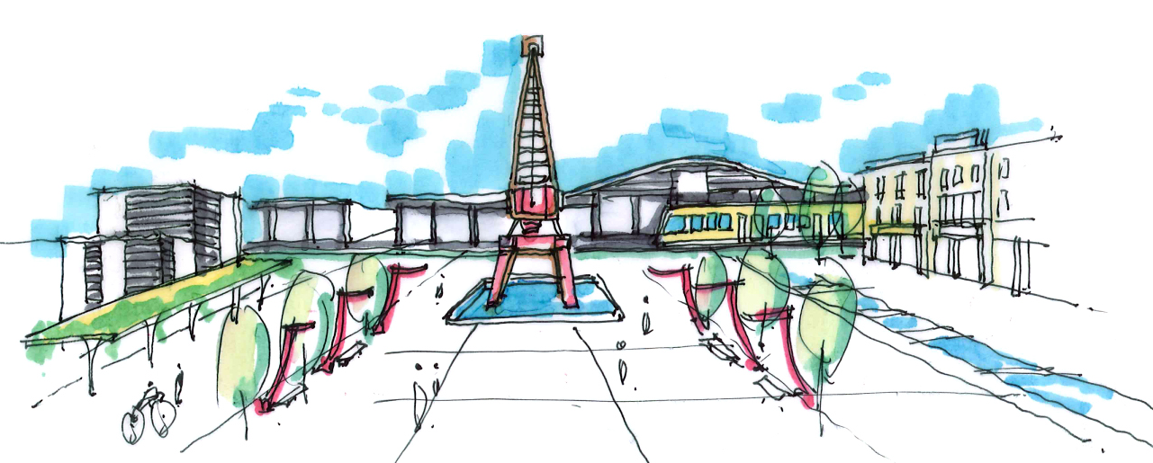
Transition
ime o urn

Slide 15
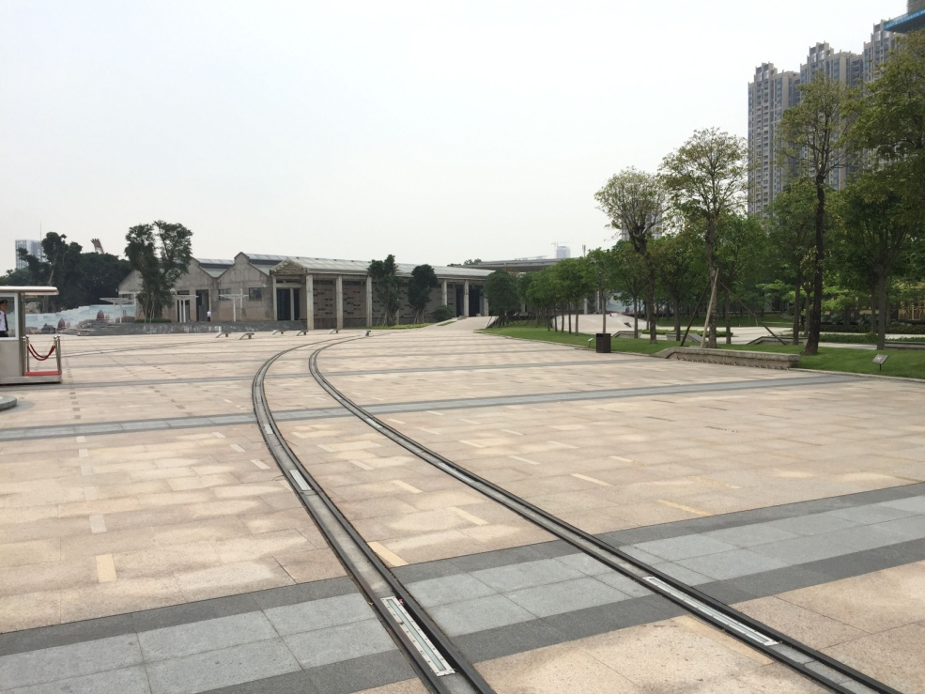
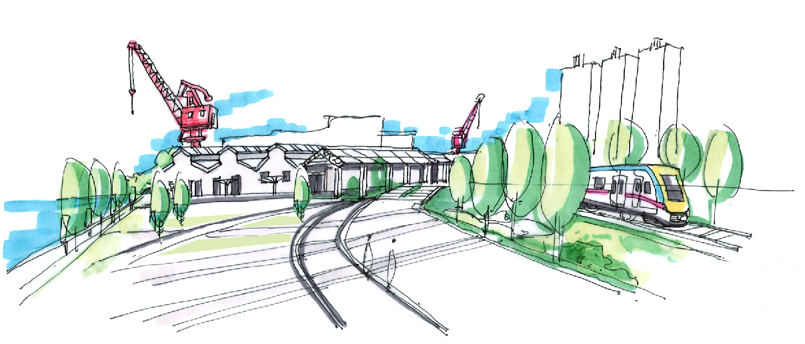
Transition
ime o urn

Slide 16
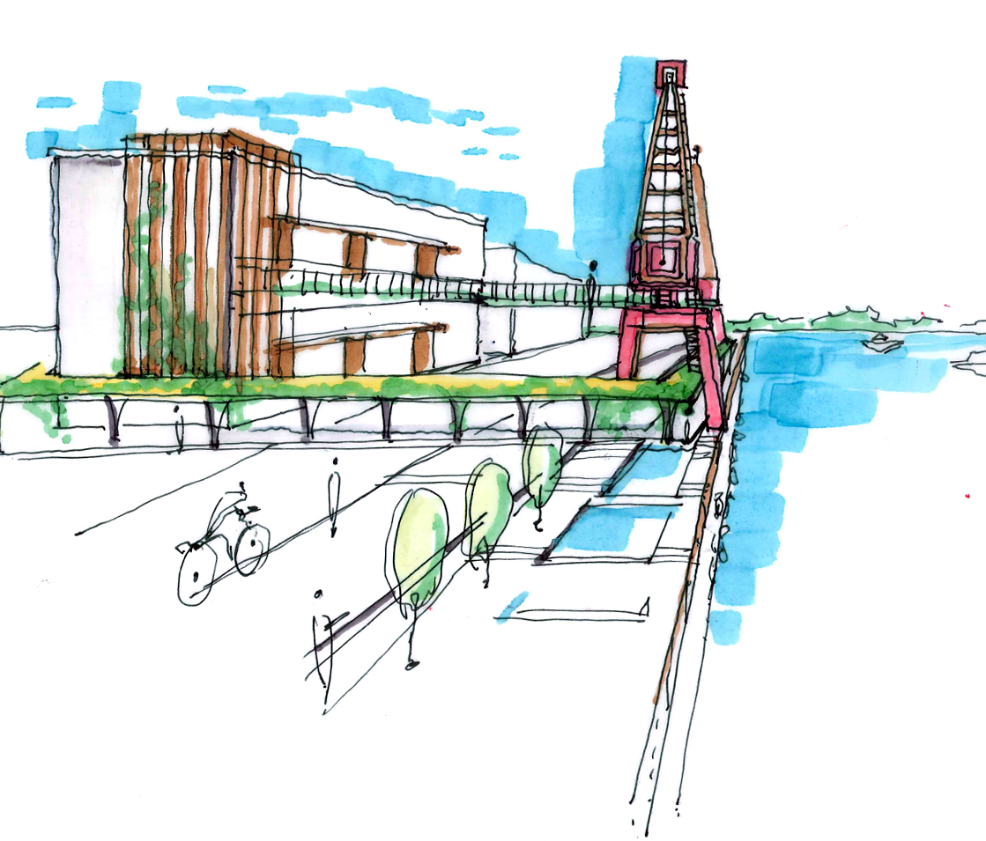
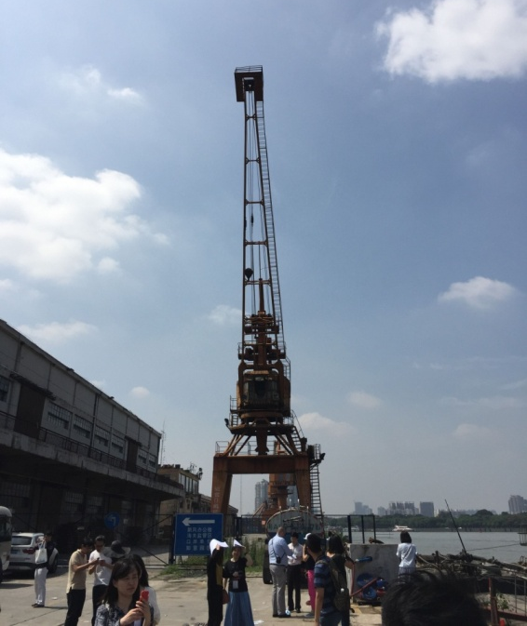
Transition
ime o urn

Slide 17
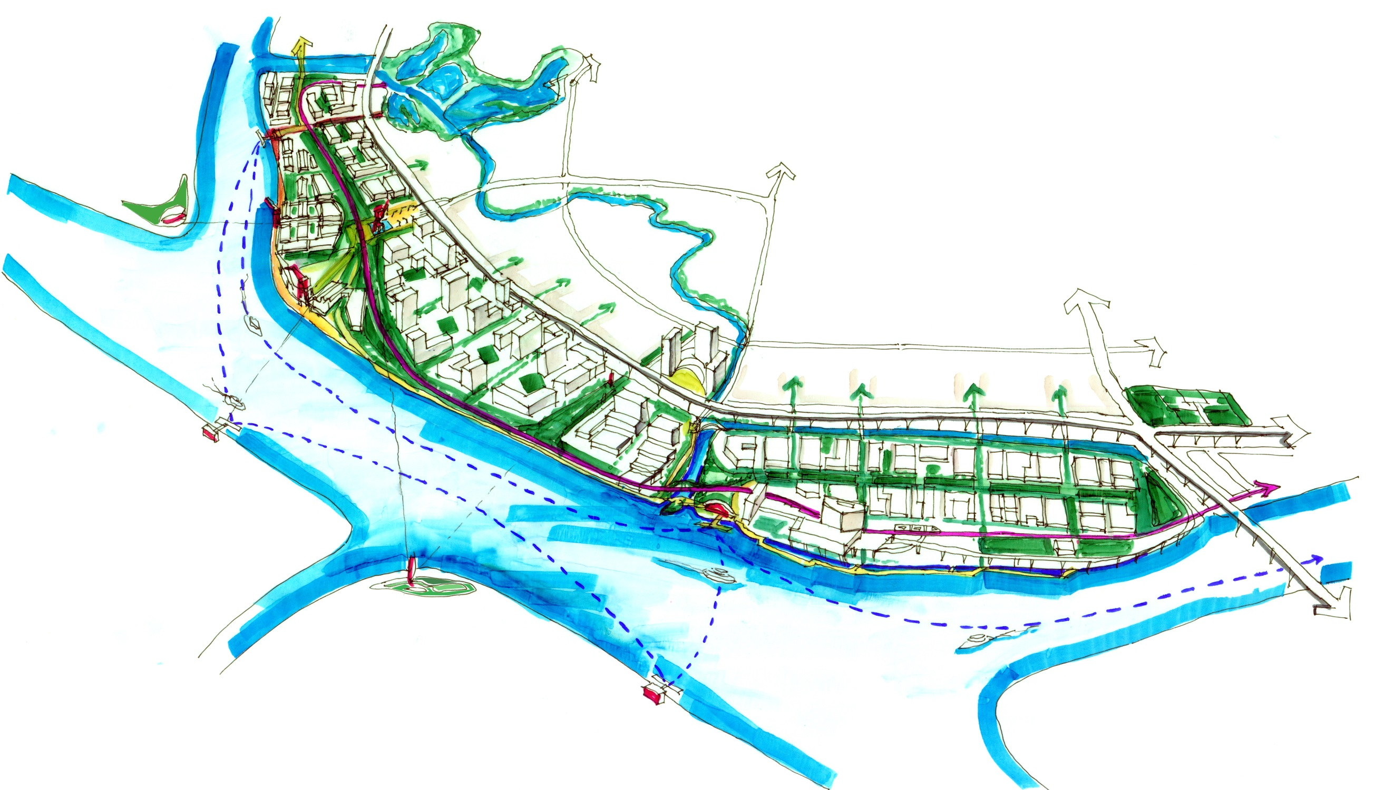
Tourism：A Series of Historical and Green Spaces
Traffic ： A Circulation system to guide people in
Trend ： A Preserved Identity for Social Groups
ime o urn

Slide 18
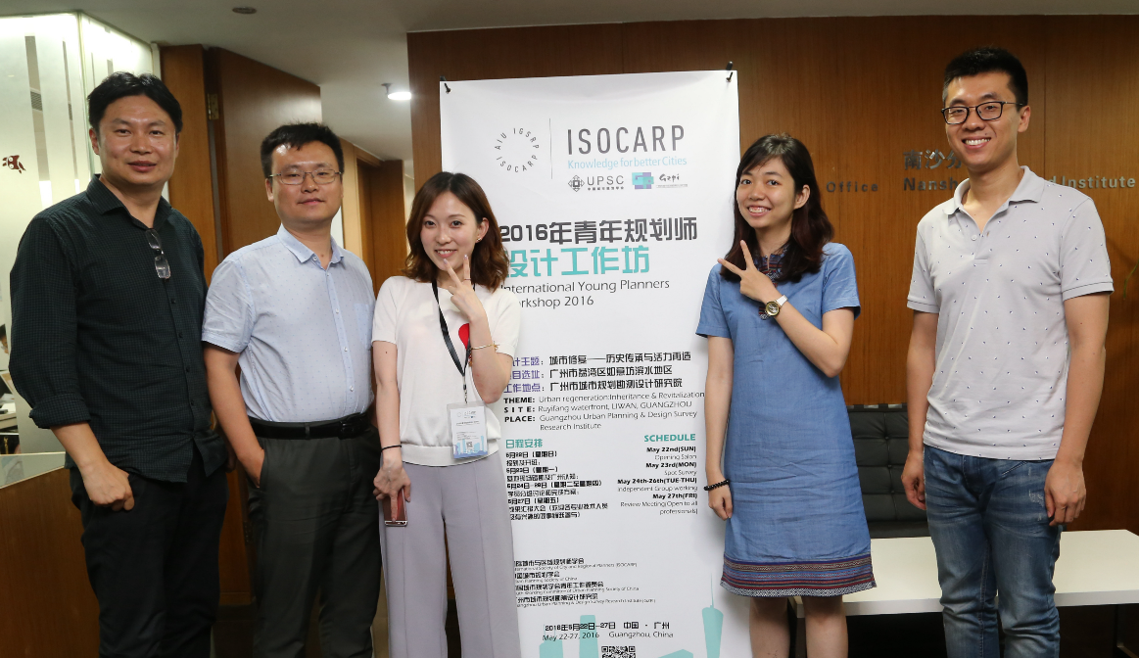
GROUP 2
Guangzhou, 2016
Phuong HUYNH ， Qingming JIAN , Ning JIANG ， Qingcong YANG ， Zhuqing LIU

