Slide 1
不破
不立

Slide 2
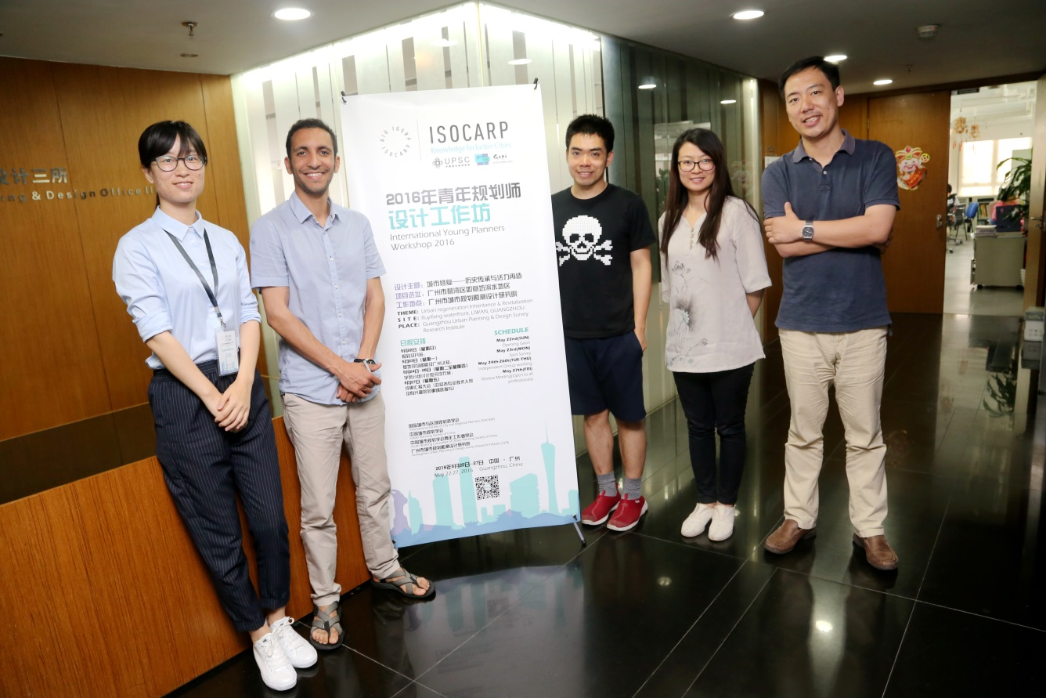
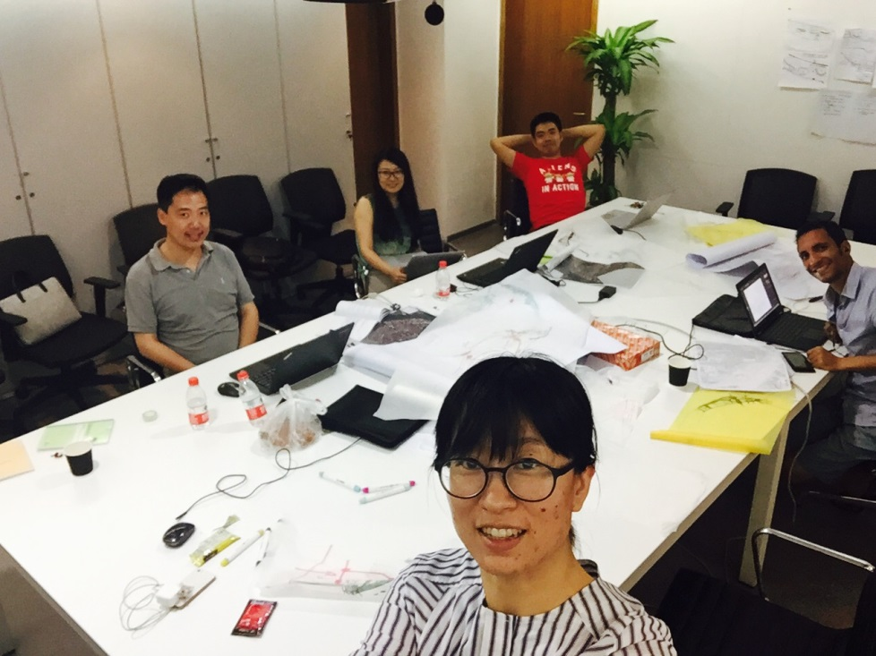
团队
Team
Moustanjidi,Yassine
Chen Wei
Hong You
Huijun Xu
Yan Zhao
2

Slide 3
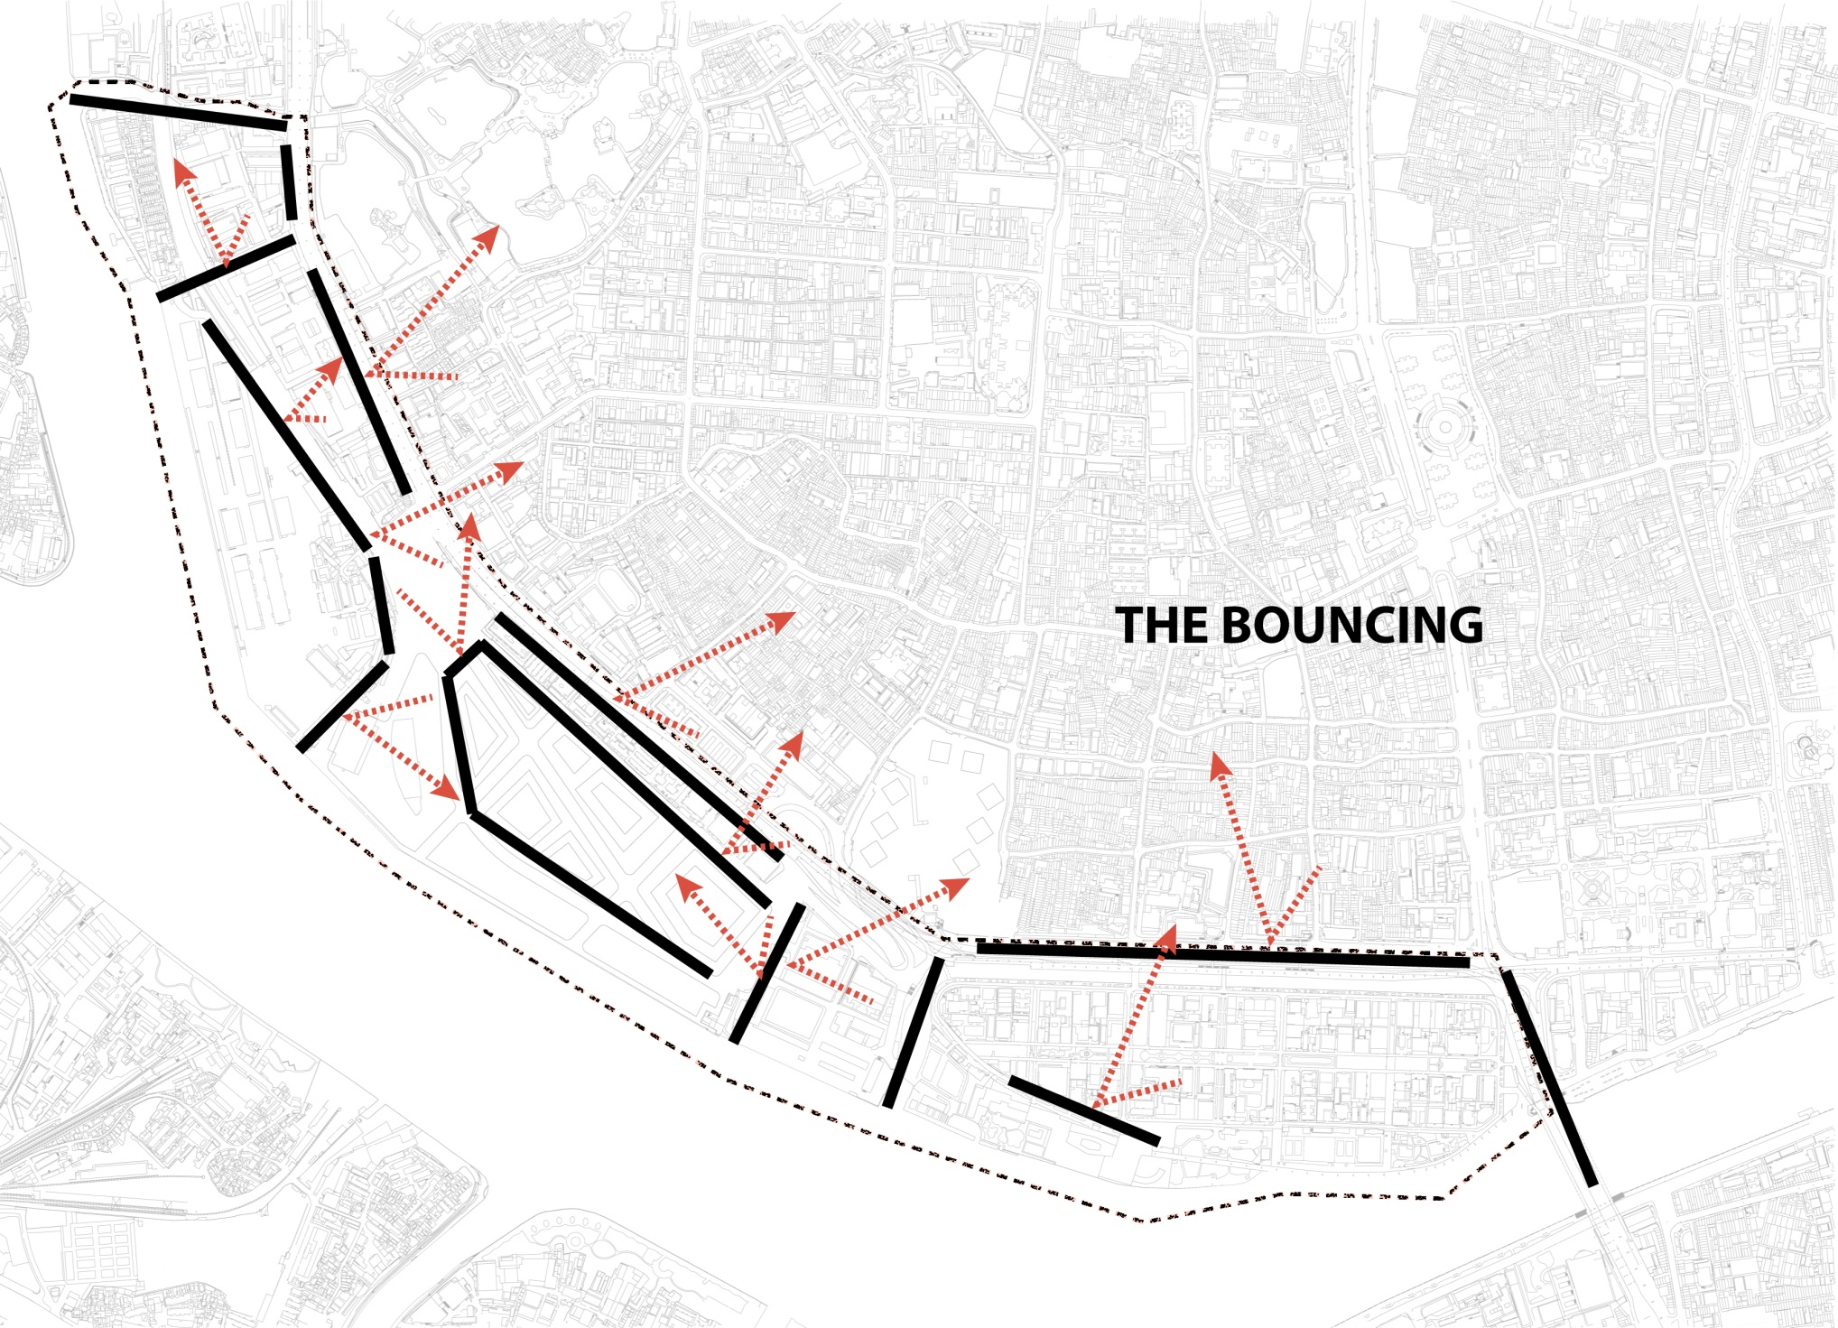
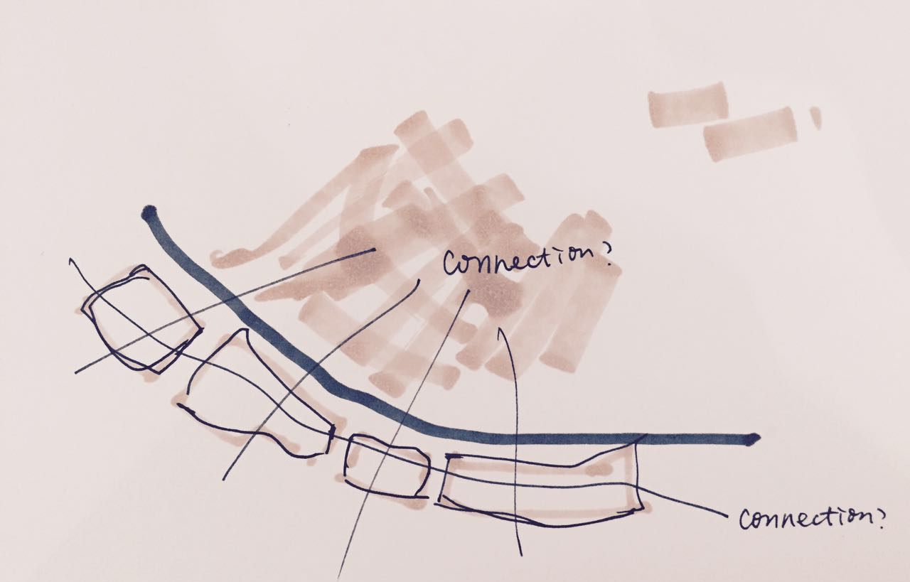
Connecting
or Breaking?…
连接？
打破思维定式……
2

Slide 4
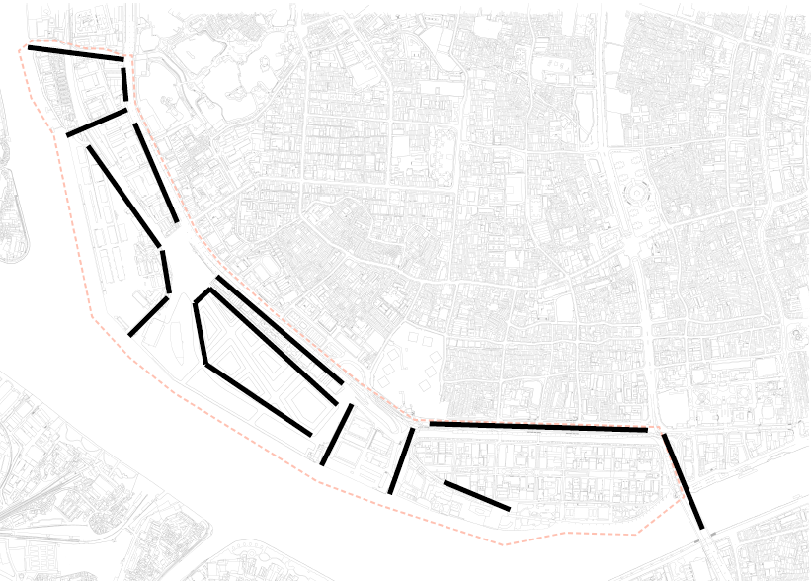
Instead of connection ——
”Breaking”
Break blocks outside
Break water front inside
Break old city cannel
Break “meridians” of the old city

Slide 5
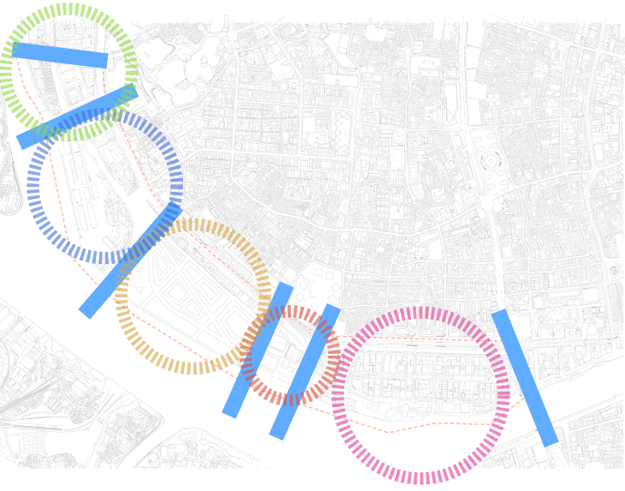
Instead of connecting ——
”Breaking”
Break blocks outside
Break water front inside
Break old city cannel
Break “meridians” of the old city

Slide 6
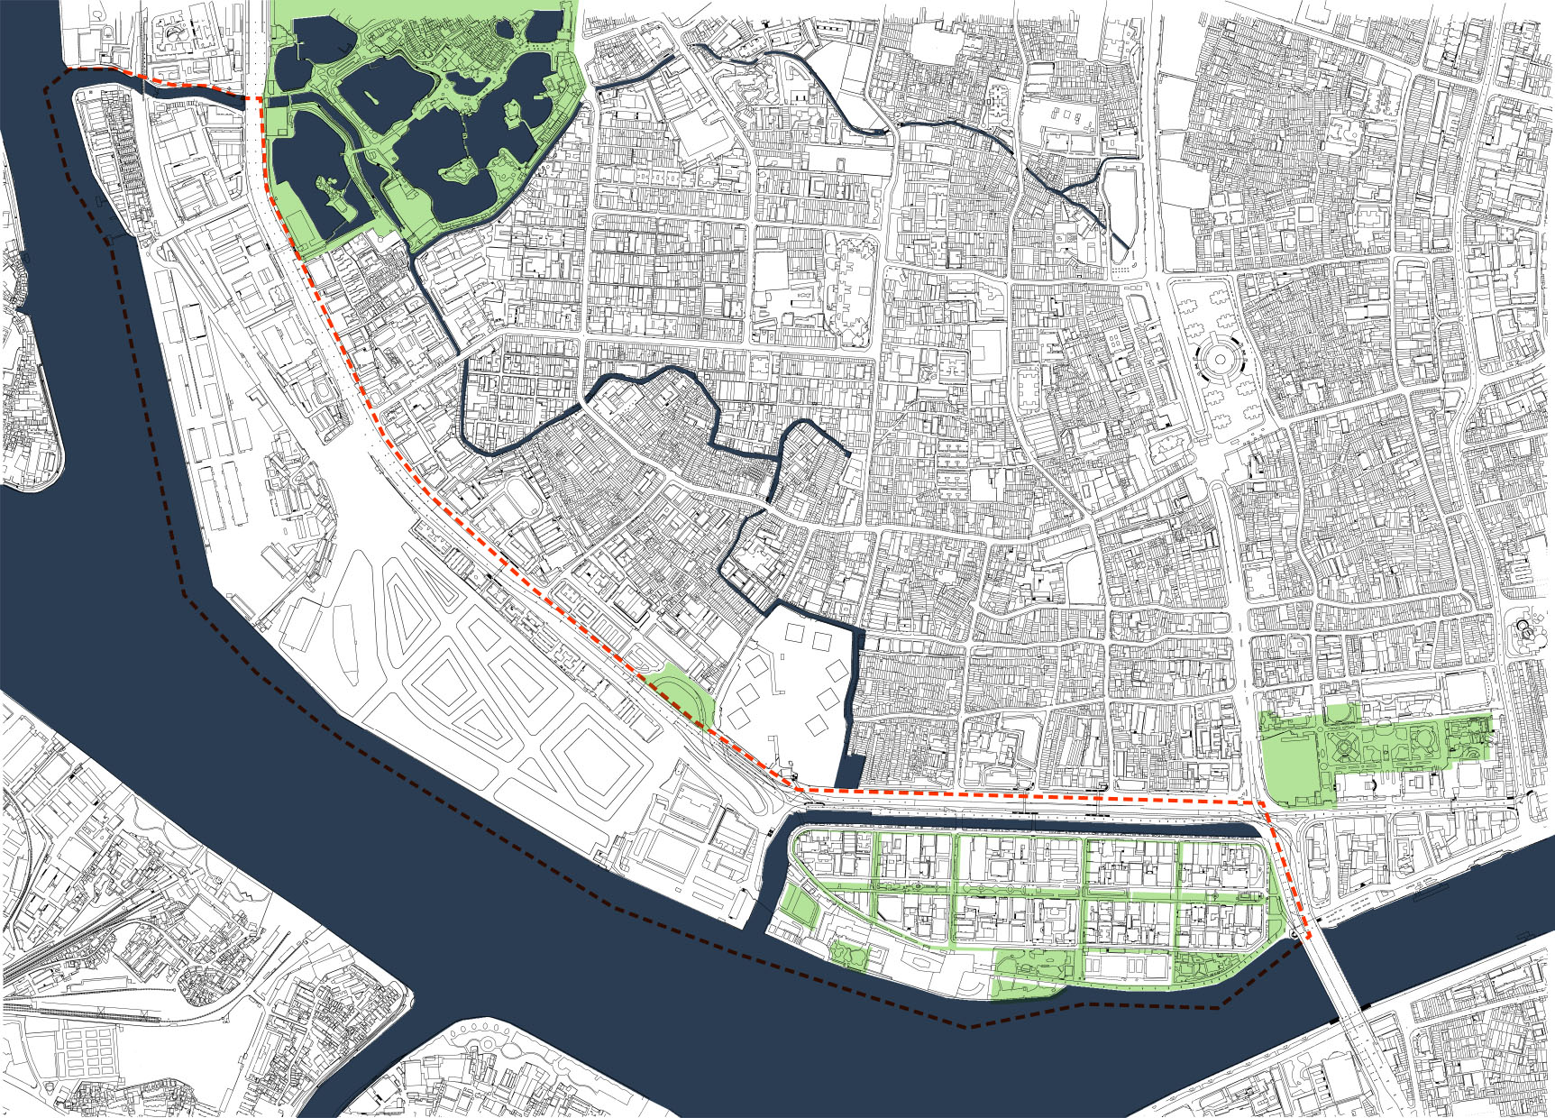
Instead of connecting ——
”Breaking”
Break blocks outside
Break water front inside
Break old city cannel
Break “meridians” of the old city

Slide 7
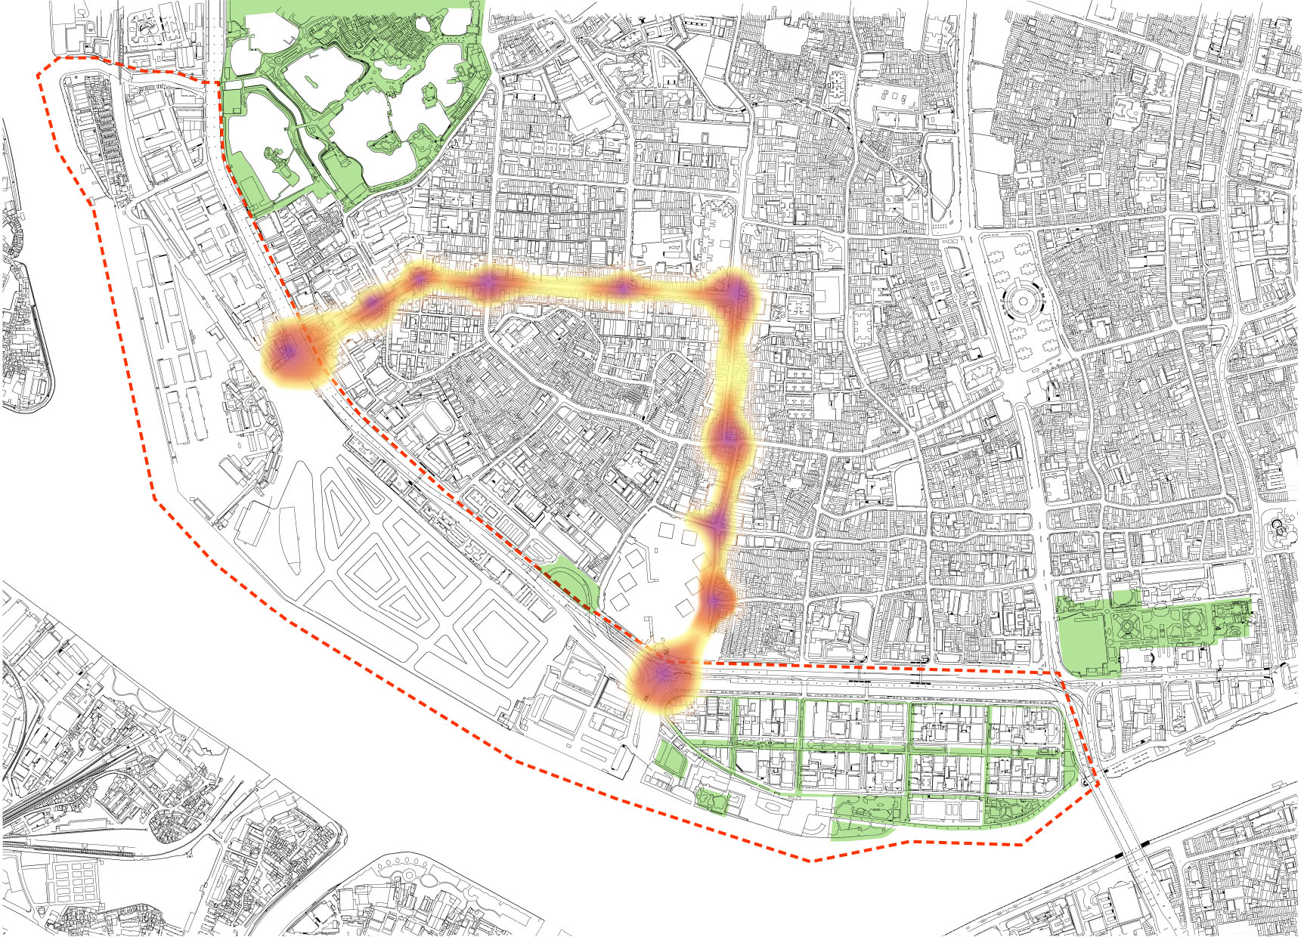
Instead of connecting ——
”Breaking”
Break blocks outside
Break water front inside
Break old city cannel
Break “meridians” of the old city

Slide 8
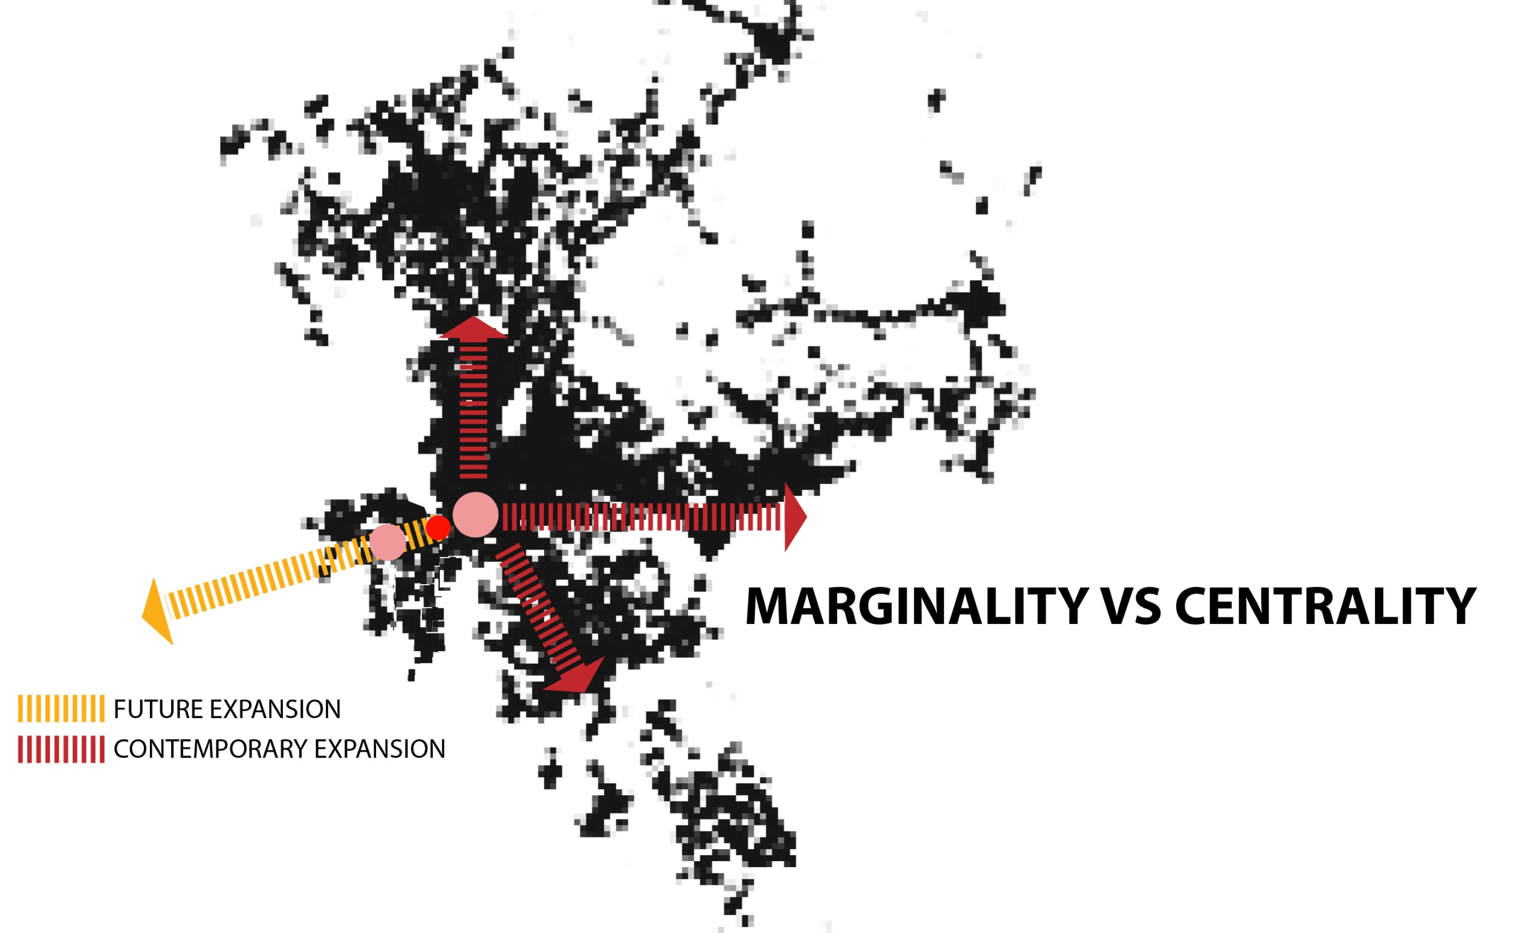
For the city
——”Breaking” the develop pattern!
A historical area,
as a new development core connecting the east
To Foshan.
对城市而言，这样的“打破”让广州旧城成为新的整体，
西连佛山，是改变城市发展格局的一种“突破”。
2
Site
基地
New CBD
新城中心
Foshan
佛山

Slide 9
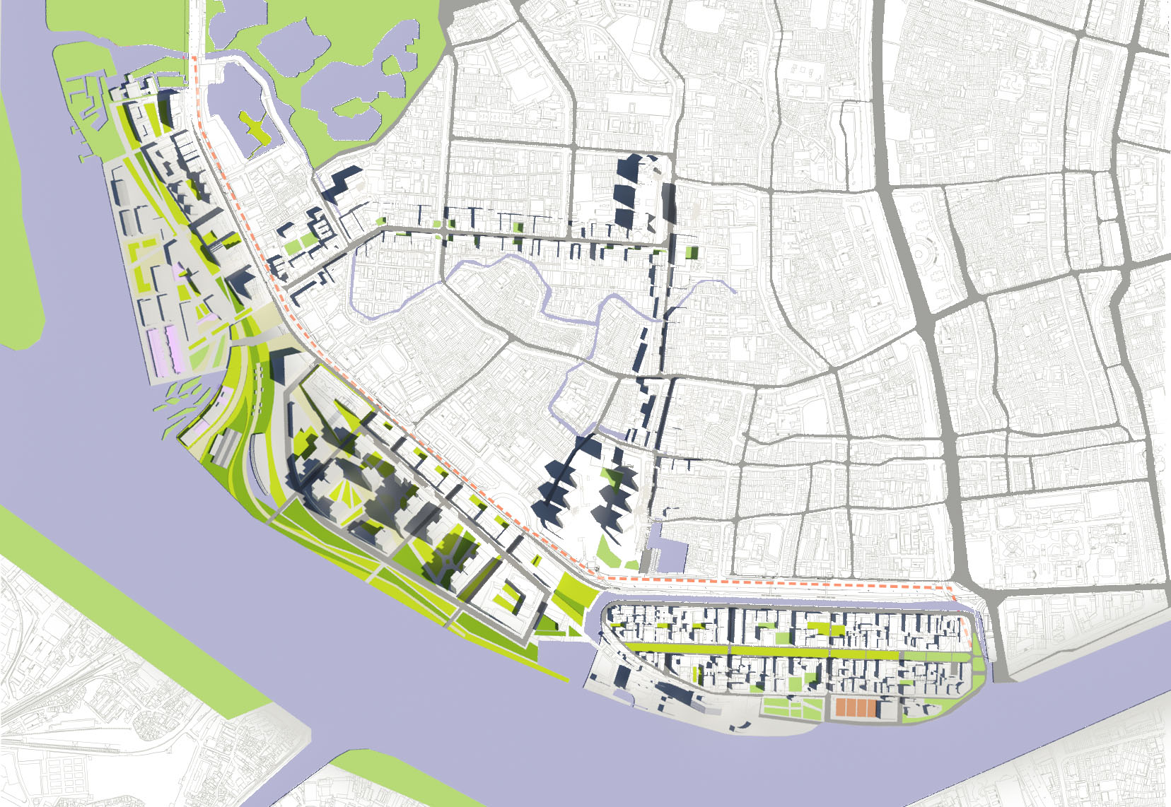
规划
Plan
Site planning
/总平面

Slide 10
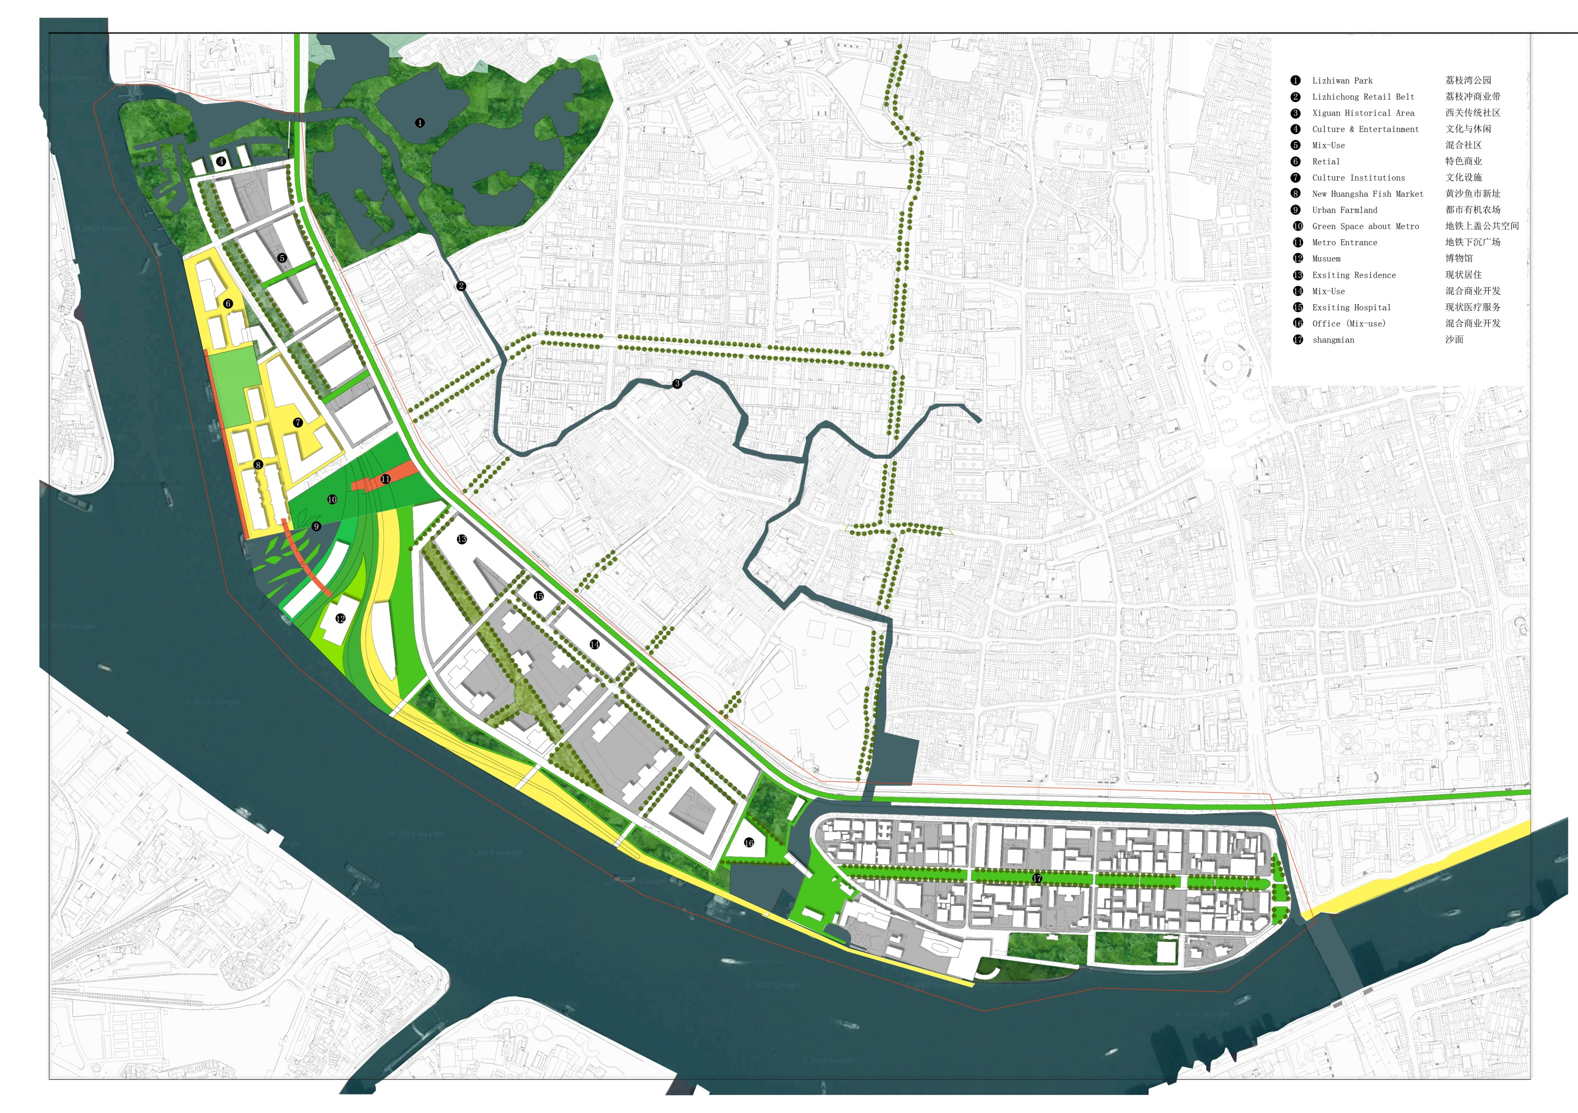
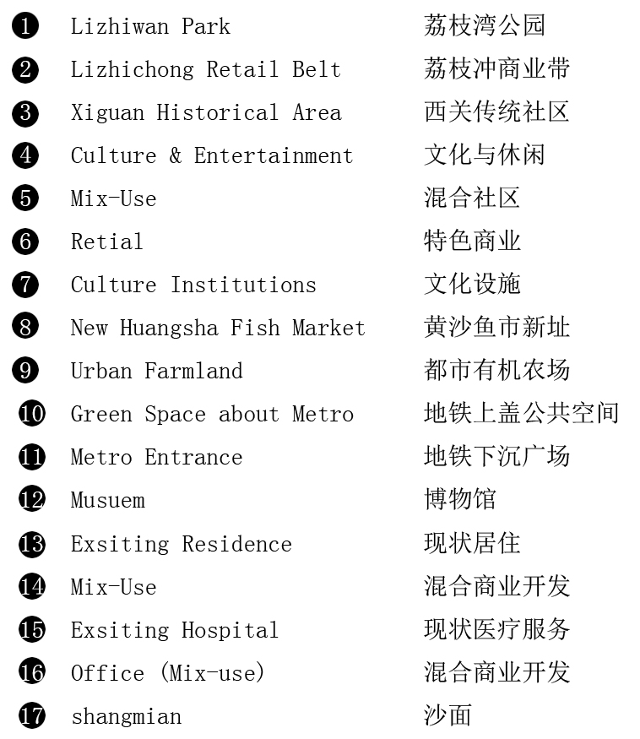
规划
Plan
Site planning
/总平面

Slide 11
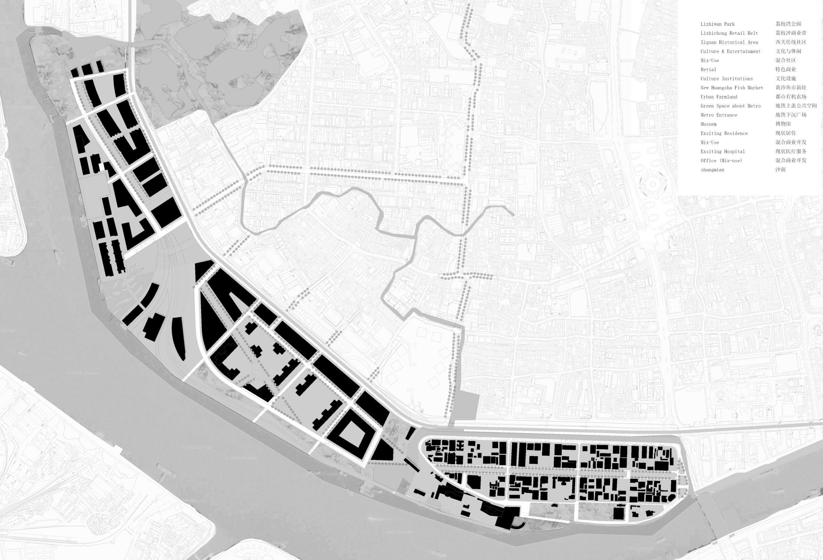
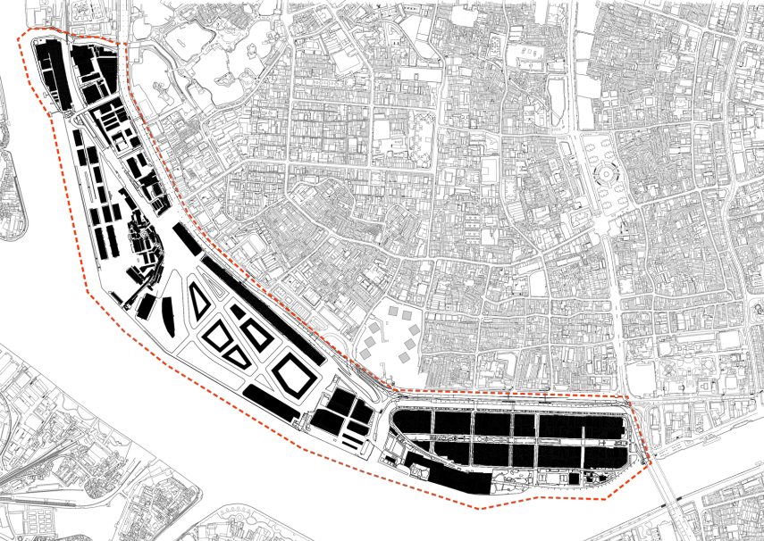
规划
Plan
Figure ground/图底关系
After
Before

Slide 12

规划
Plan
Open space/开敞空间

Slide 13
规划
Plan
Function/功能分区
more mixed use
more commerial area
more open space
more public facilities
更多：混合使用、商业空间
公共空间、公共服务设施
Mixed-Use
Fish-market
Retail
Existing Residence
Mixed-Use
Shamian Mix-Use

Slide 14
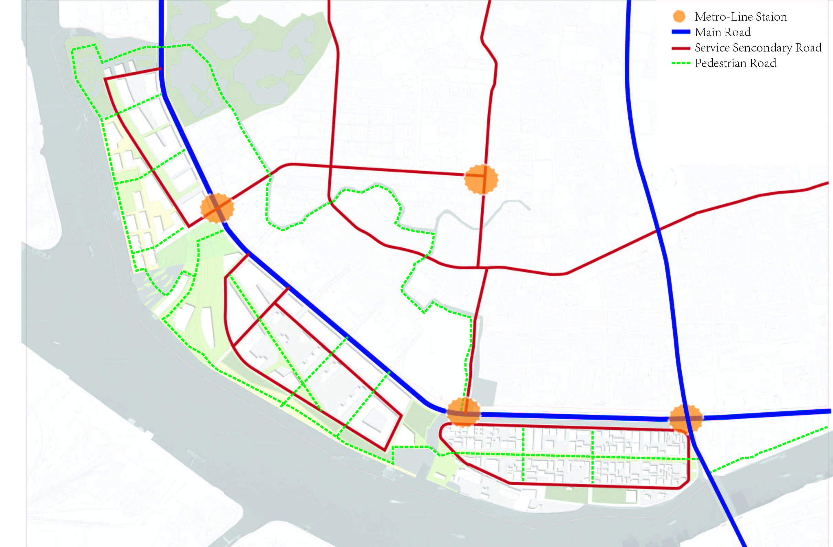
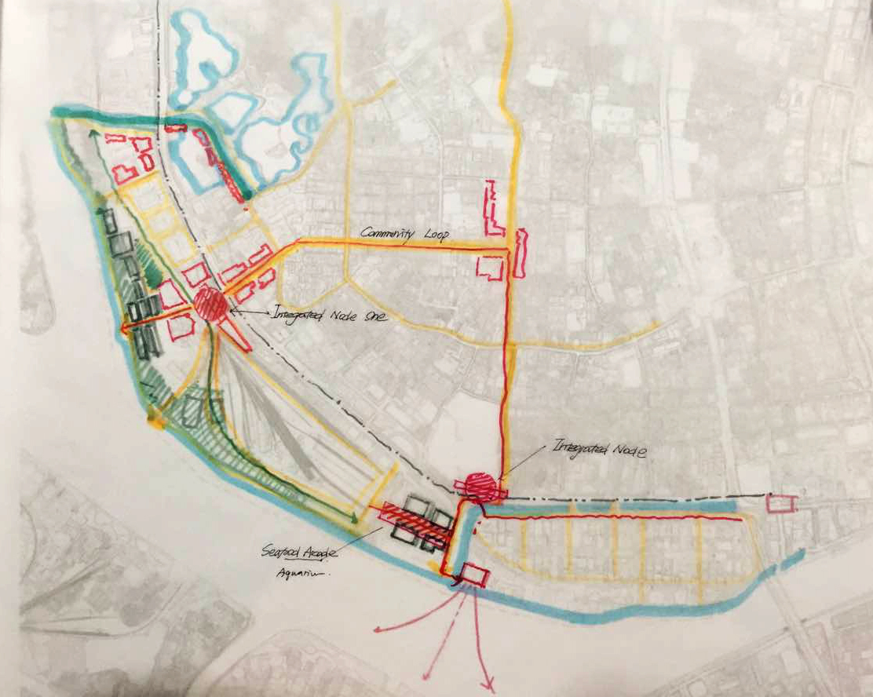
规划
Plan
Circulation
/综合联系
500m
500m

Slide 15

规划
Plan
Highlights/亮点
Move the seafood
market to the Xinfeng
Harbor and update.
/将鱼市搬迁至
新风港并升级

Slide 16
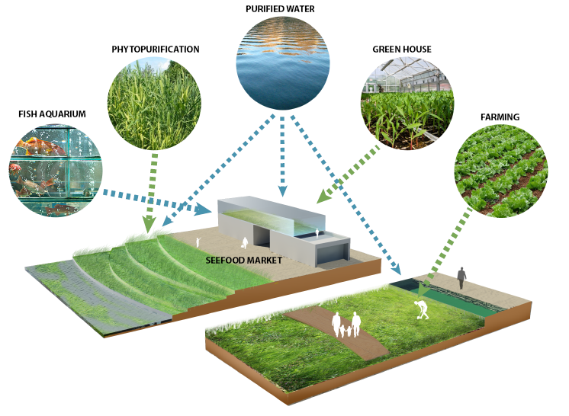
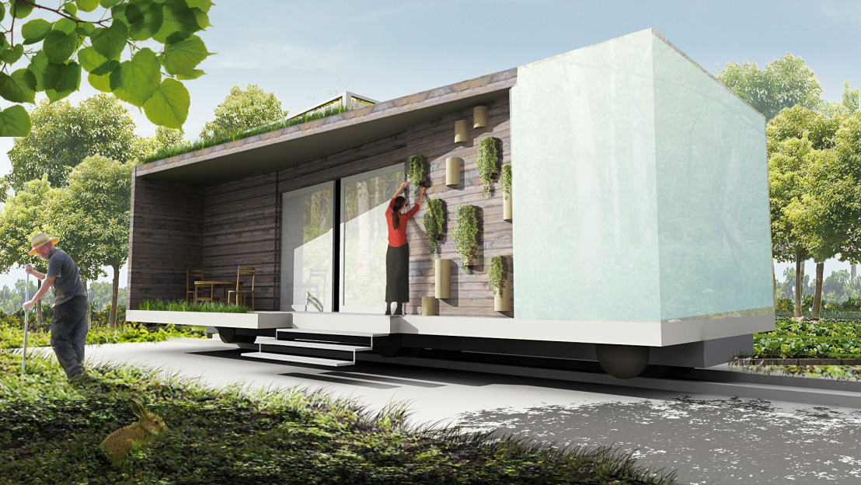
规划
Plan
Highlights/亮点

Slide 17
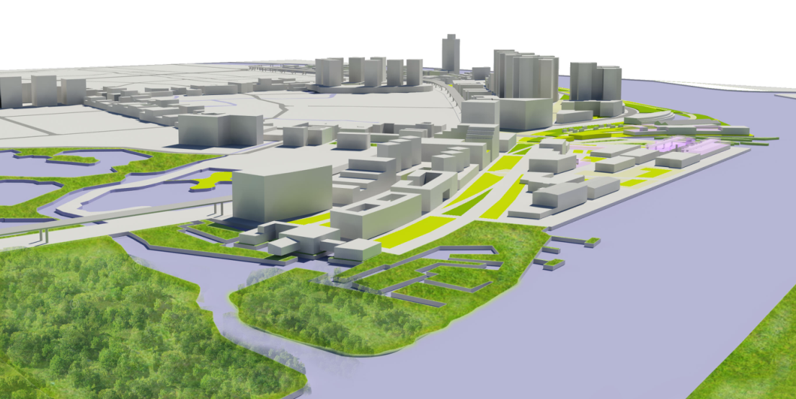
规划
Plan
Highlights/亮点

Slide 18
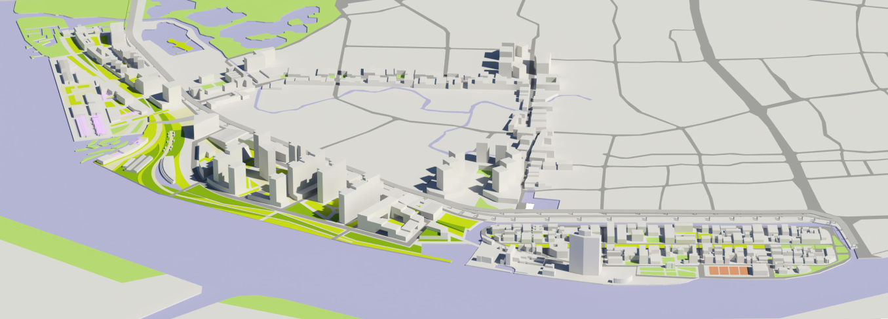
规划
Plan
Highlights/亮点

Slide 19
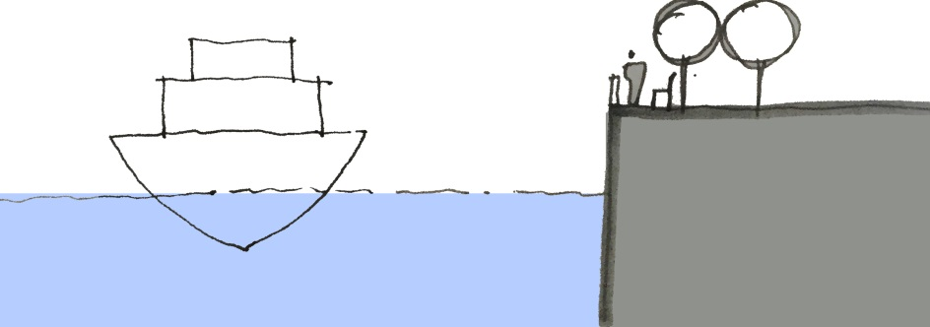
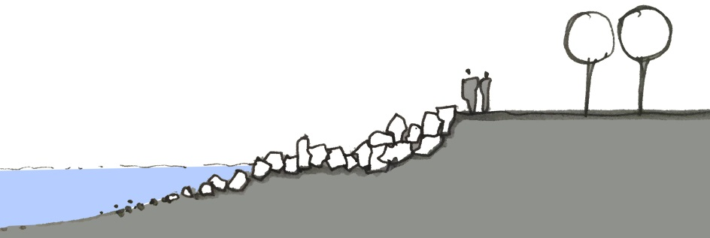
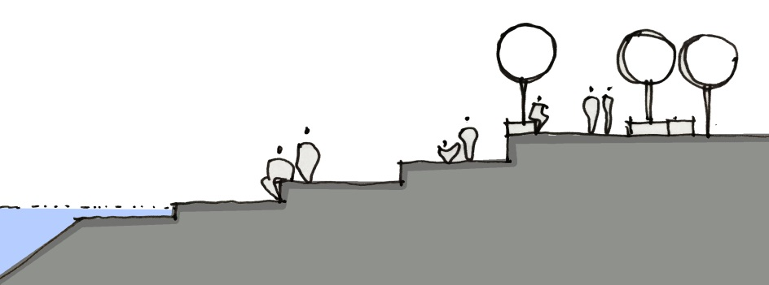
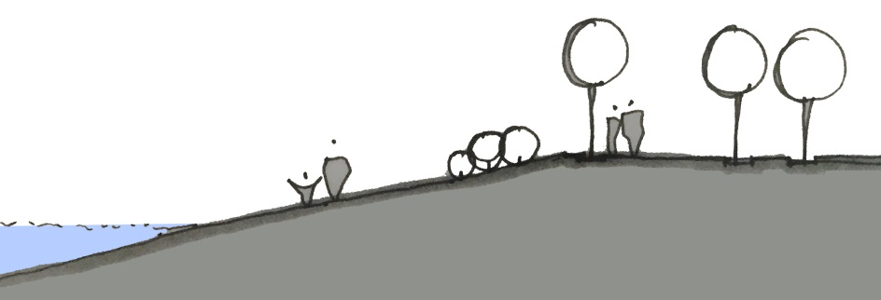
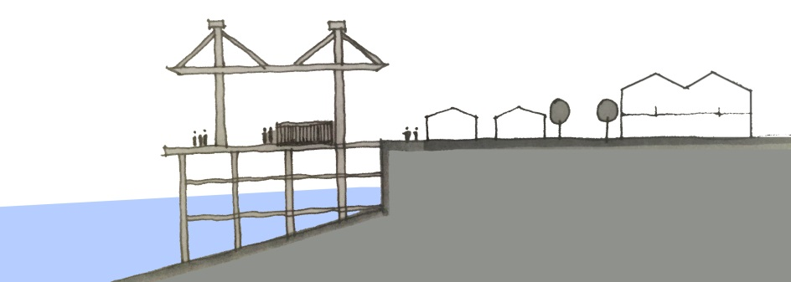
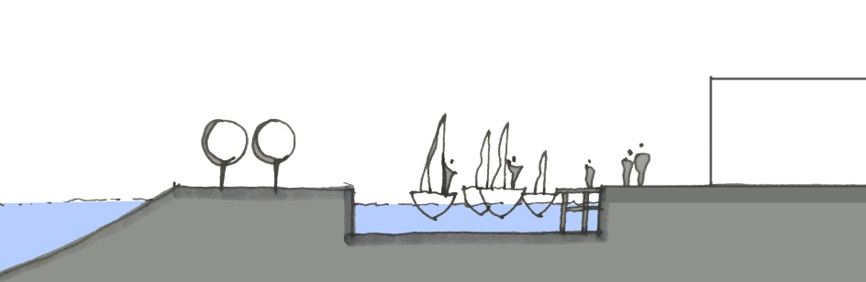
规划
Plan
Highlights/亮点

Slide 20
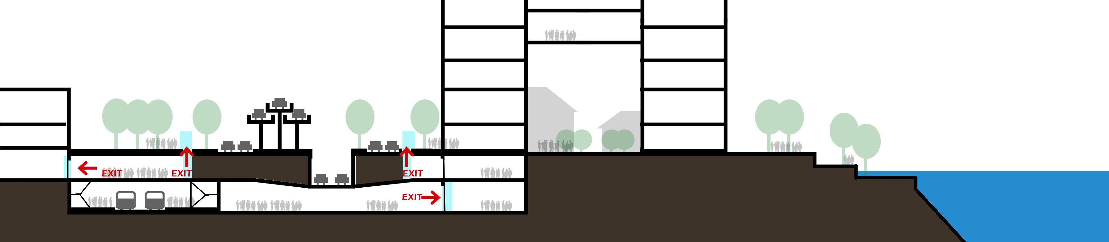
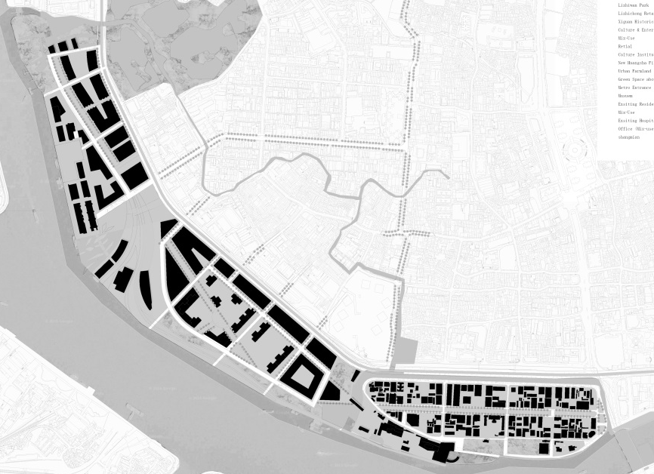
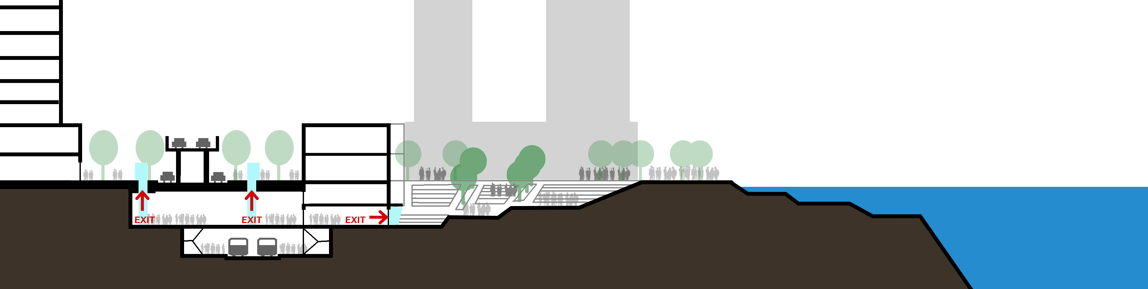
规划
Plan
Highlights/亮点

Slide 21
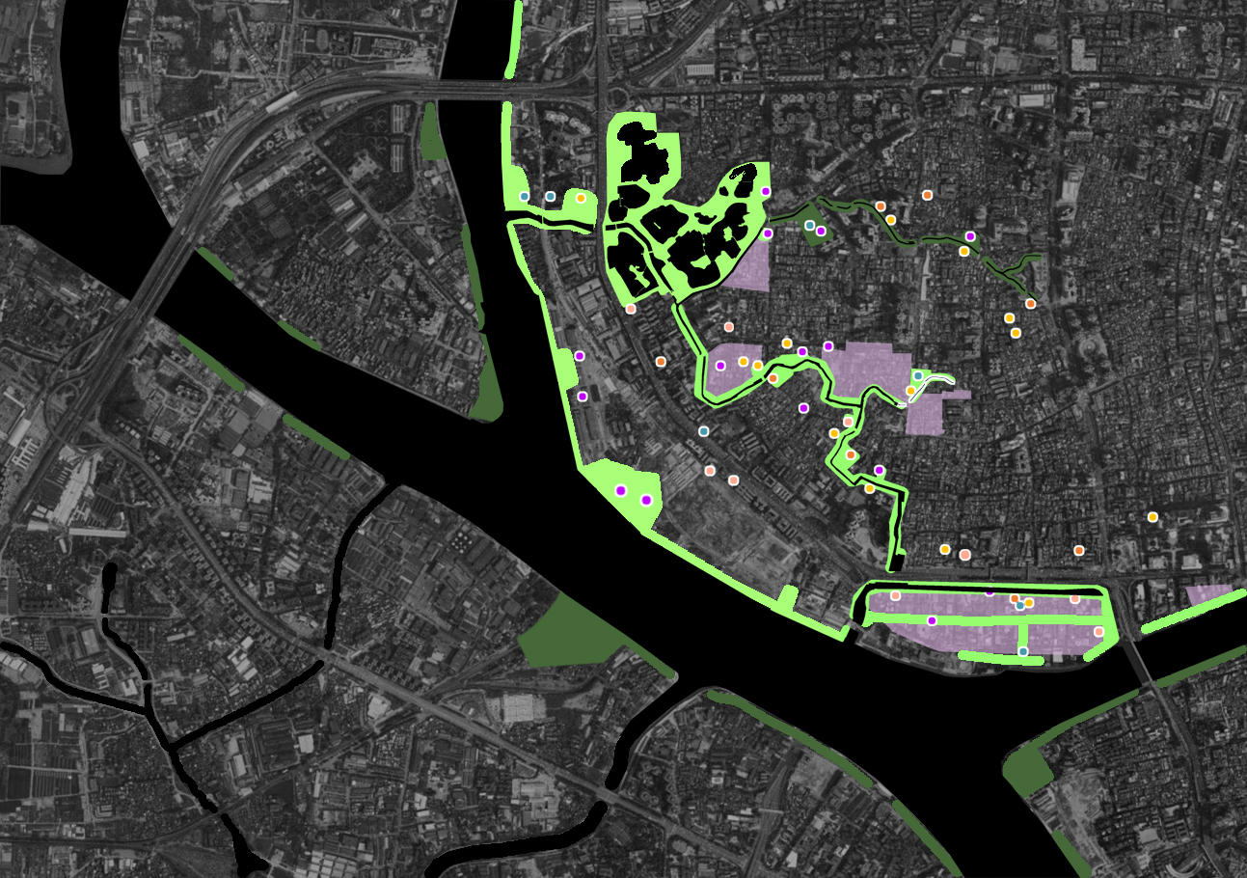
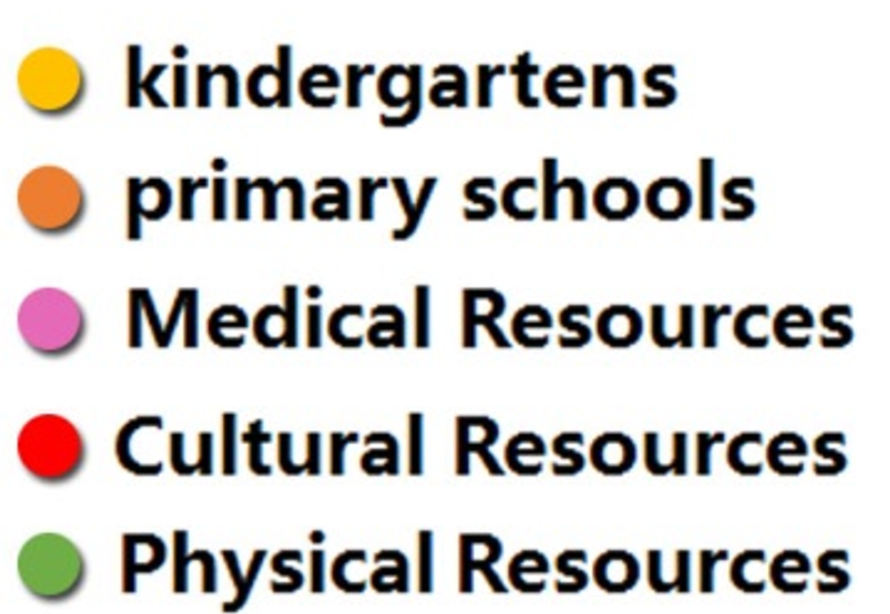

规划
Plan
Highlights/亮点
双桥烟雨
水系——连接的核心
向内：城市活力的连接，串联公共资源，设施内外共享，向外：景观和城市记忆的连接
Water as a Linkage Core,
Link to the Pulic Resources of the inner city, and to the landscape & culture resources outside of the city
双桥烟雨
鹅潭夜月
Historic cultural landscape

Slide 22
展望
Future
“Breaking”is
the beginning.

